Slide 1

Cette année, retombez amoureux de CSS ❤️

Slide 2

(re) devenez copain avec le CSS ❤️

Slide 3






Olivier Leplus
Developer Advocate @
Google Developer Expert
@olivierleplus
Arnaud JEAN
Solutions Architect @
linkedin.com/in/ajean-cloud

Slide 4


Olivier Leplus
Developer Advocate @
Google Developer Expert
@olivierleplus
Yohan Lasorsa
Developer Advocate @
Google Developer Expert
@sinedied

Slide 5


Style Queries
color-mix()
:focus-visible
Scroll Snapping
Nesting
Media Query L4
@Scope
aspect-ratio
:modal
:has()
color-scheme
scrollbar-gutter
Custom Properties
Cascade Layers
accent-color
@container
Viewport Units
Variable Fonts
Anchor Positioning
COLRv1 Fonts
:is()
Container Queries
Contrast Color
Grid Track Animations
Toggle()
Color Spaces
View Transitions
Subgrid
Scroll

Slide 6
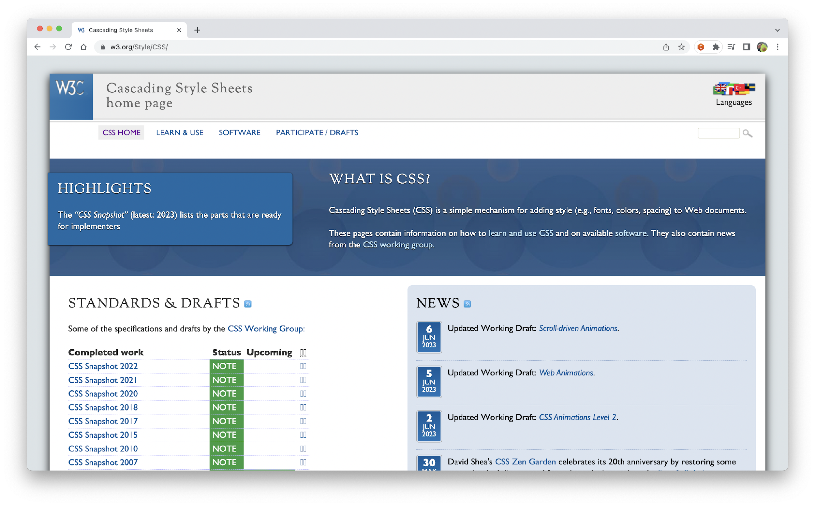
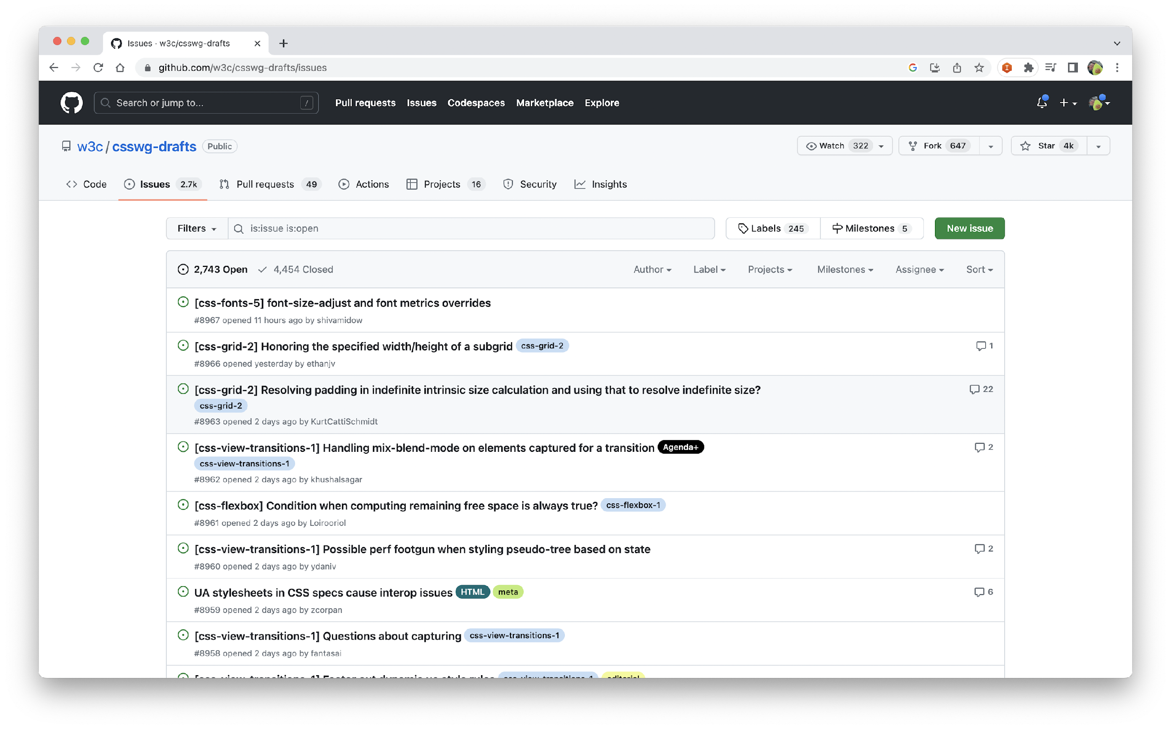
https://www.w3.org/Style/CSS
https://github.com/w3c/csswg-drafts/issues
Notes:
Equivalent du TC39

Slide 7
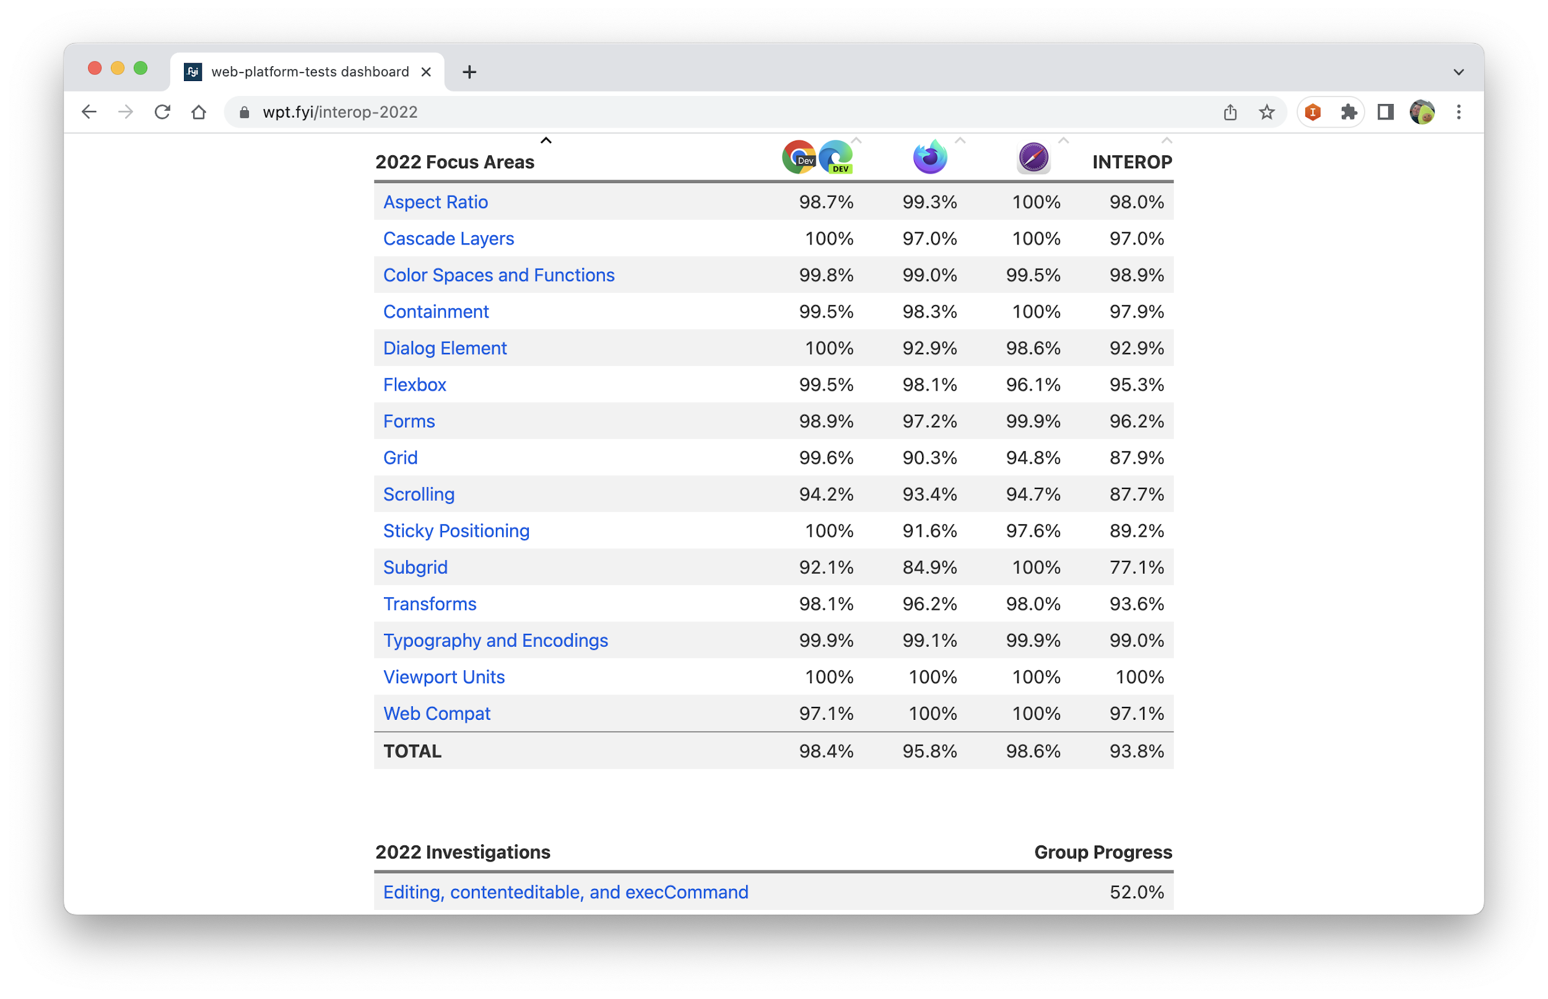
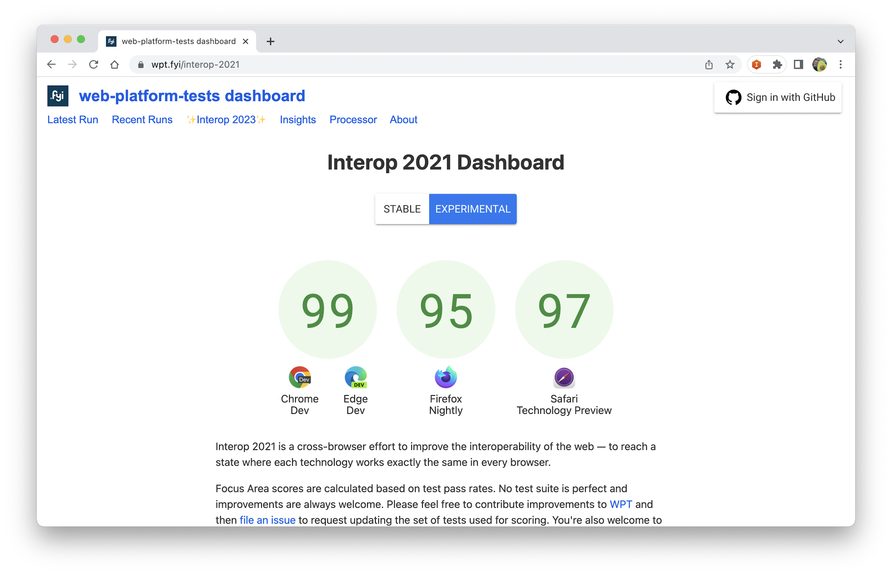
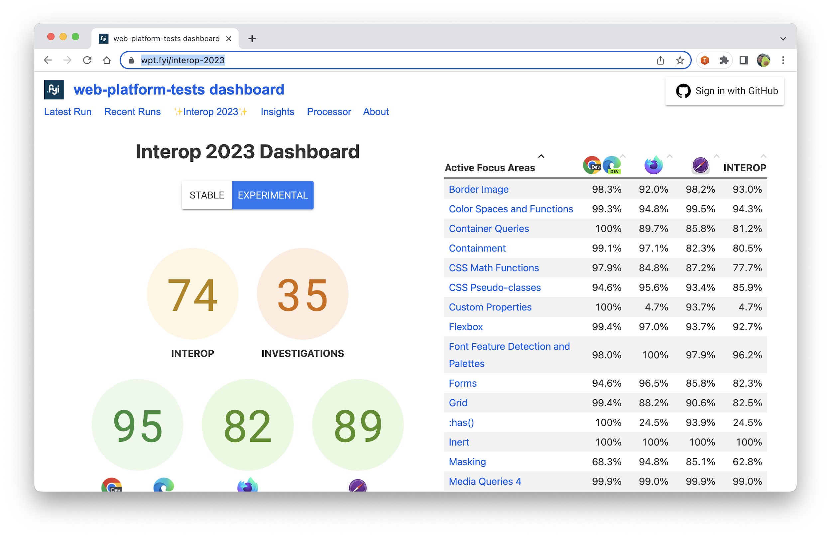
Interop
https://wpt.fyi/interop-2023

Slide 8




Custom properties
31
49
16
10
https://developer.mozilla.org/en-US/docs/Web/CSS/Using_CSS_custom_properties

Slide 9
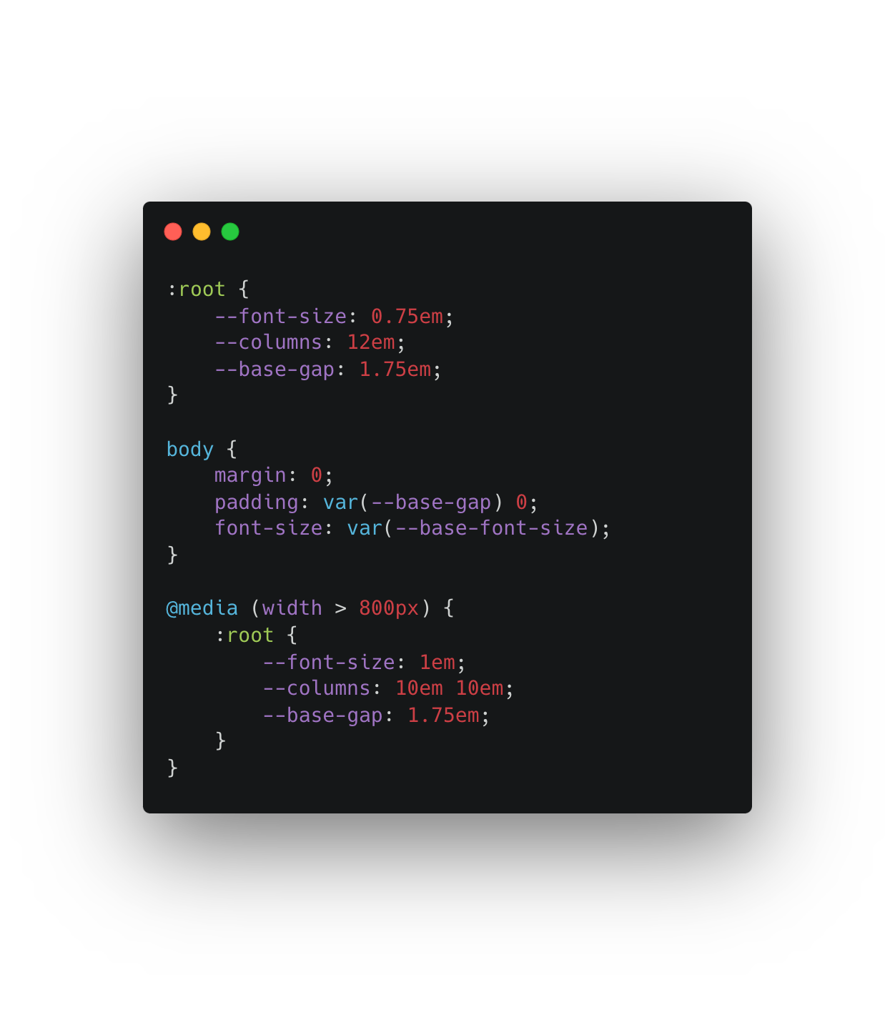
Notes:
Add demo with devtool to show that we can change them Show composition
Show how it works with JavaScript

Slide 10
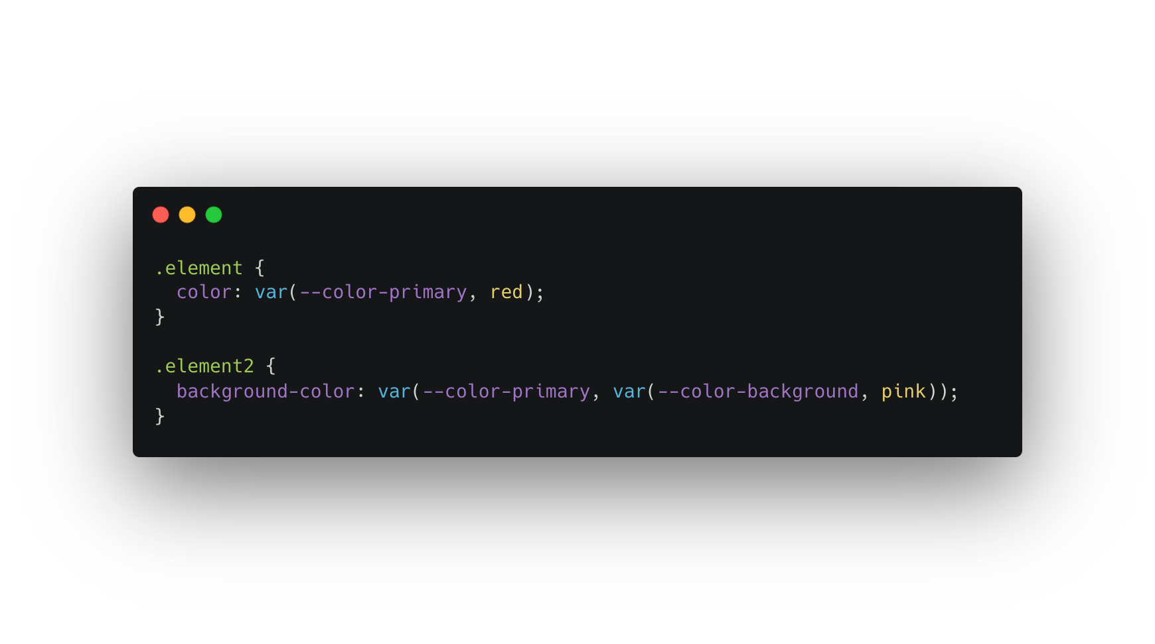
Notes:
Add demo with devtool to show that we can change them Show composition
Show how it works with JavaScript

Slide 11
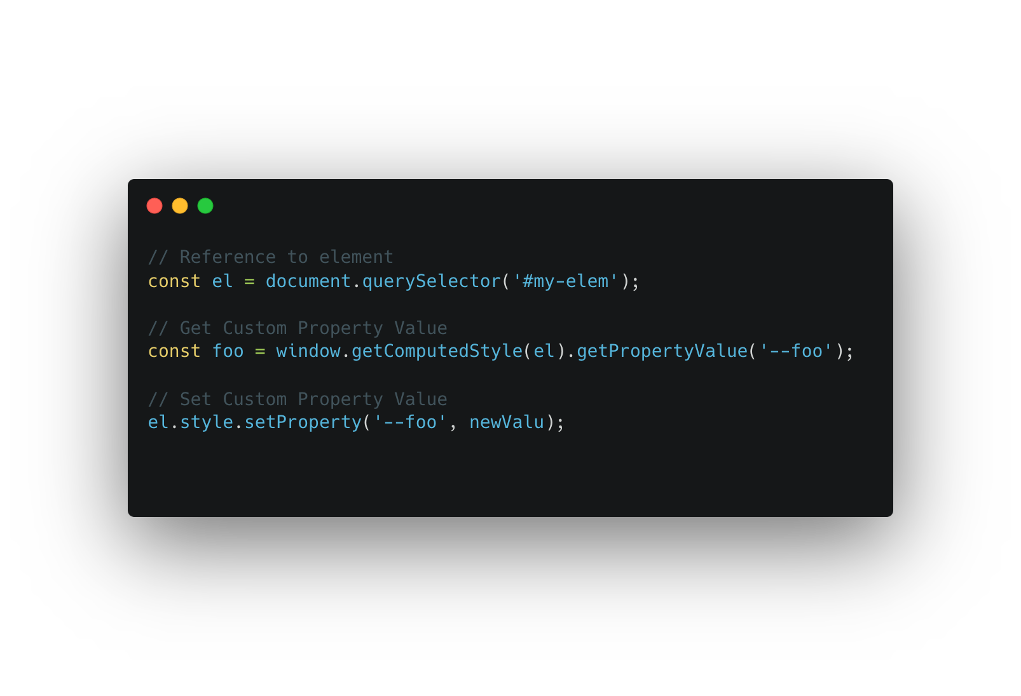
https://www.bram.us/2016/11/12/css-variables-var-subtitle/

Slide 12
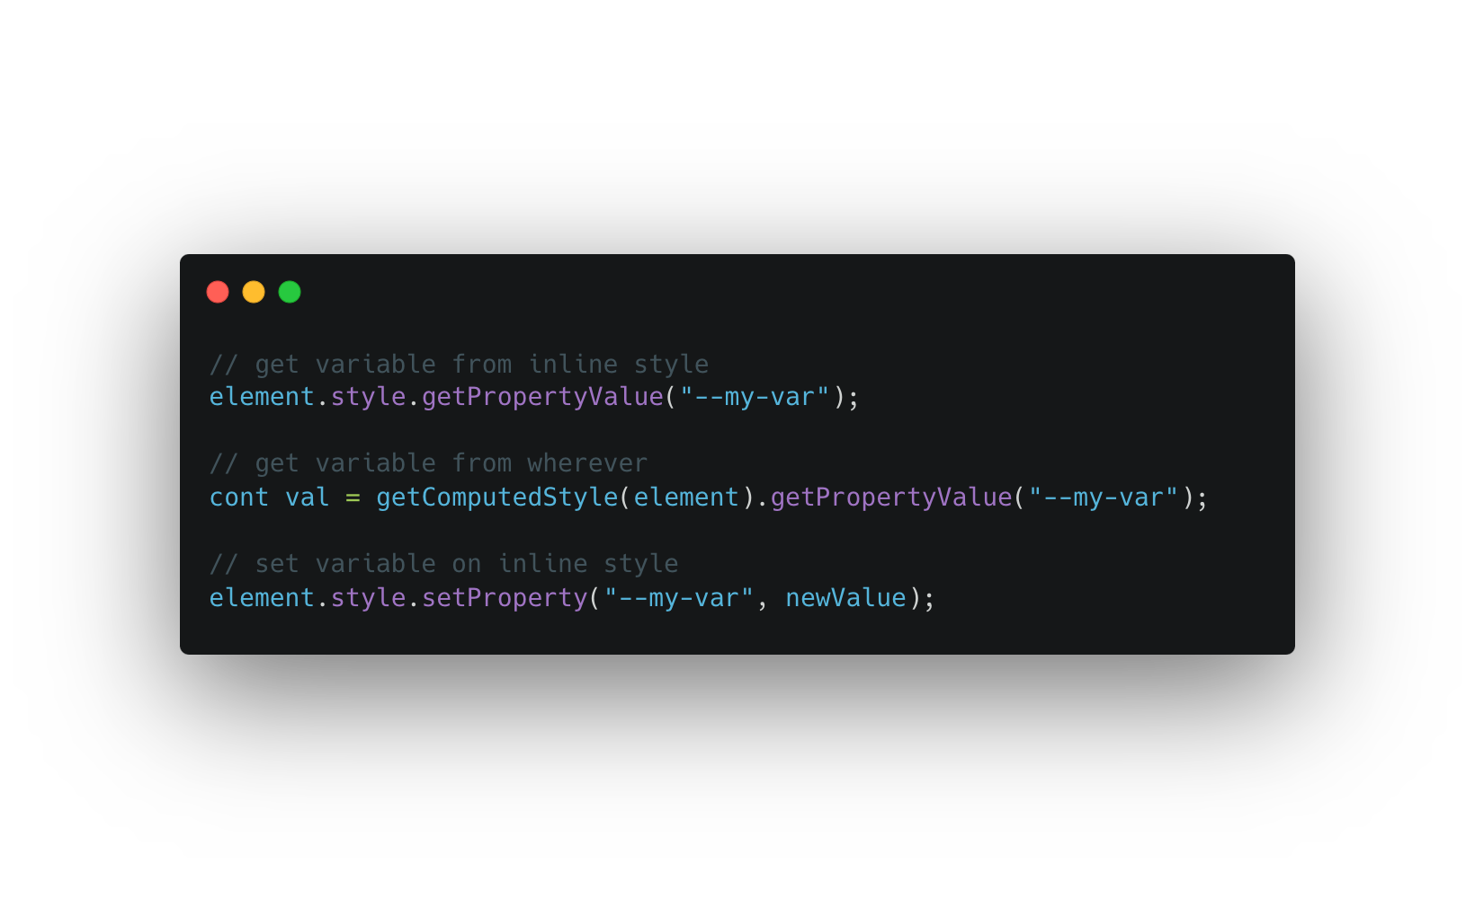
https://developer.mozilla.org/en-US/docs/Web/CSS/Using_CSS_custom_properties

Slide 13


Slide 14
CSS nesting
117
112
112
16.5
https://developer.chrome.com/articles/css-nesting/

Slide 15
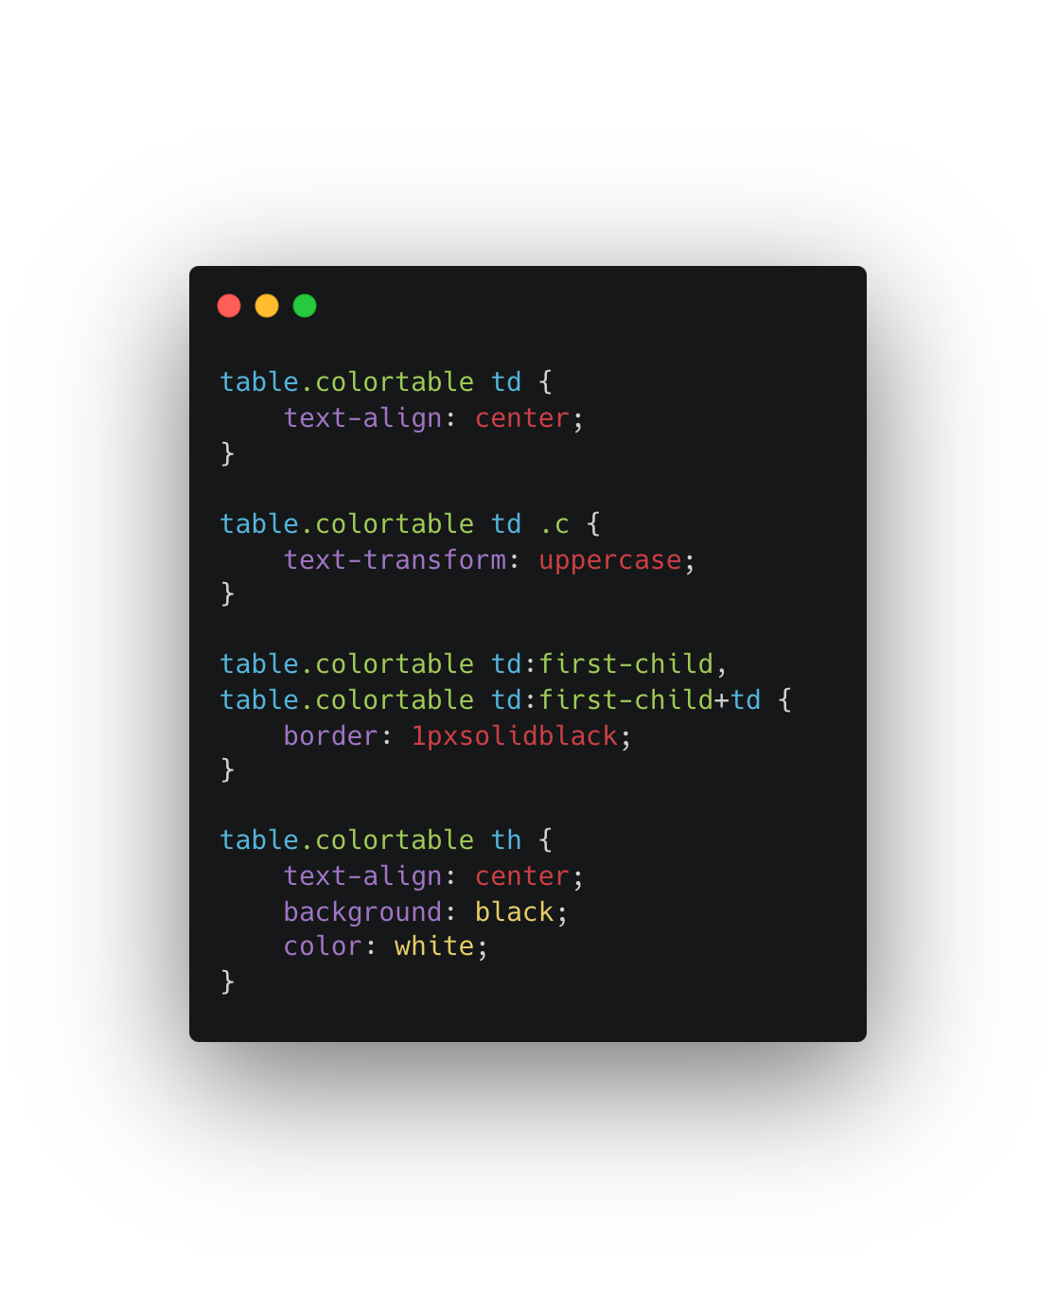
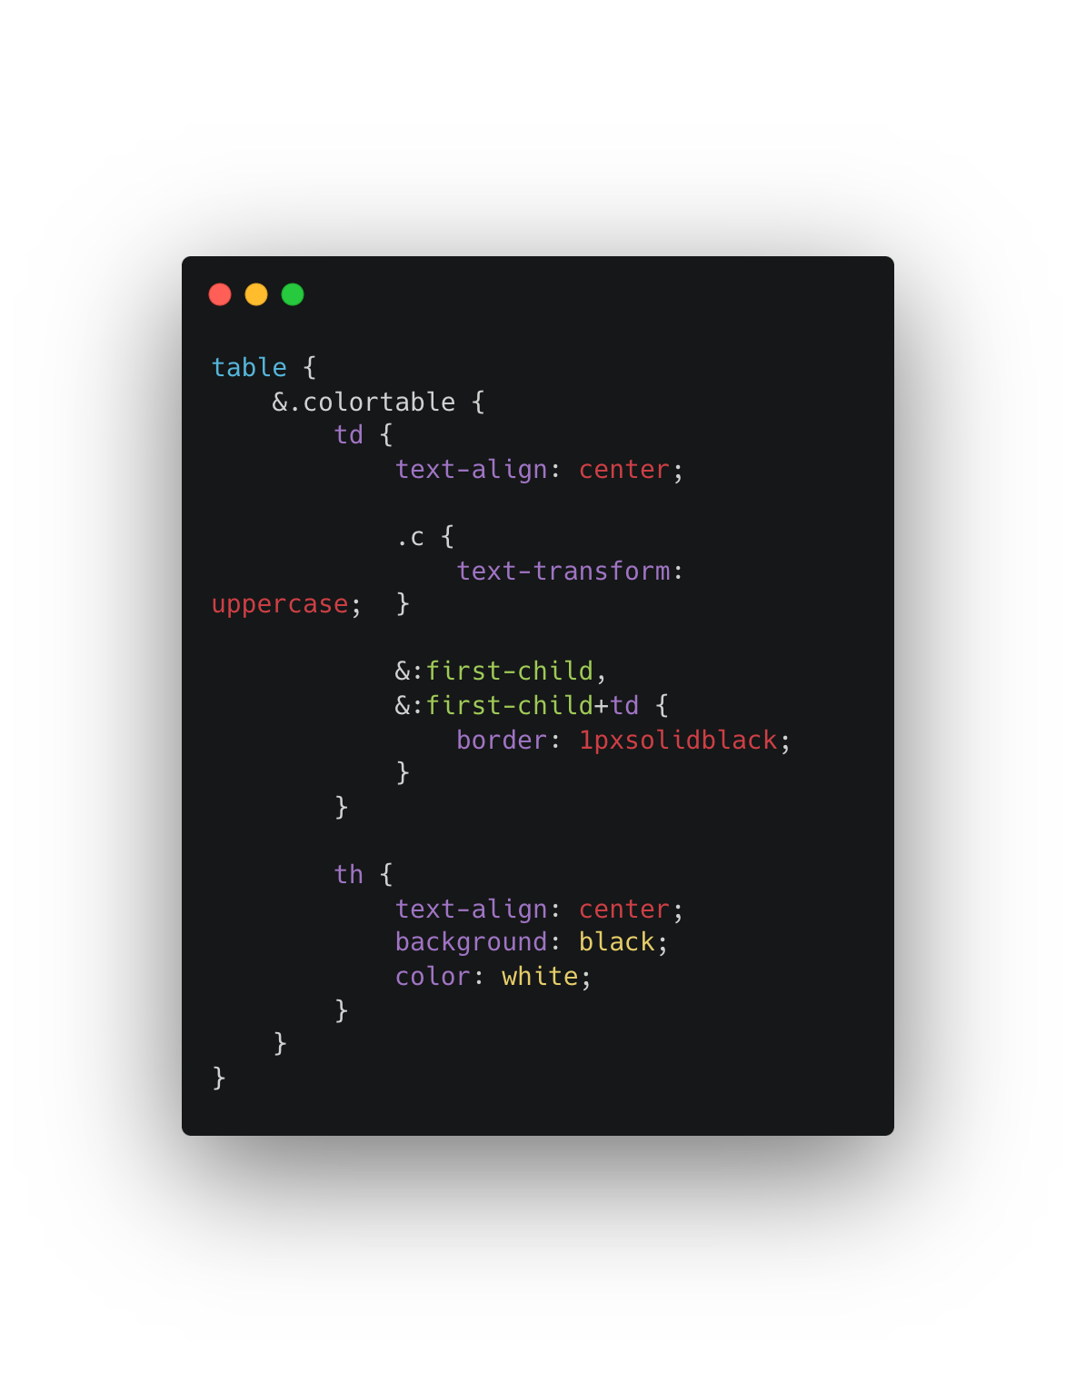
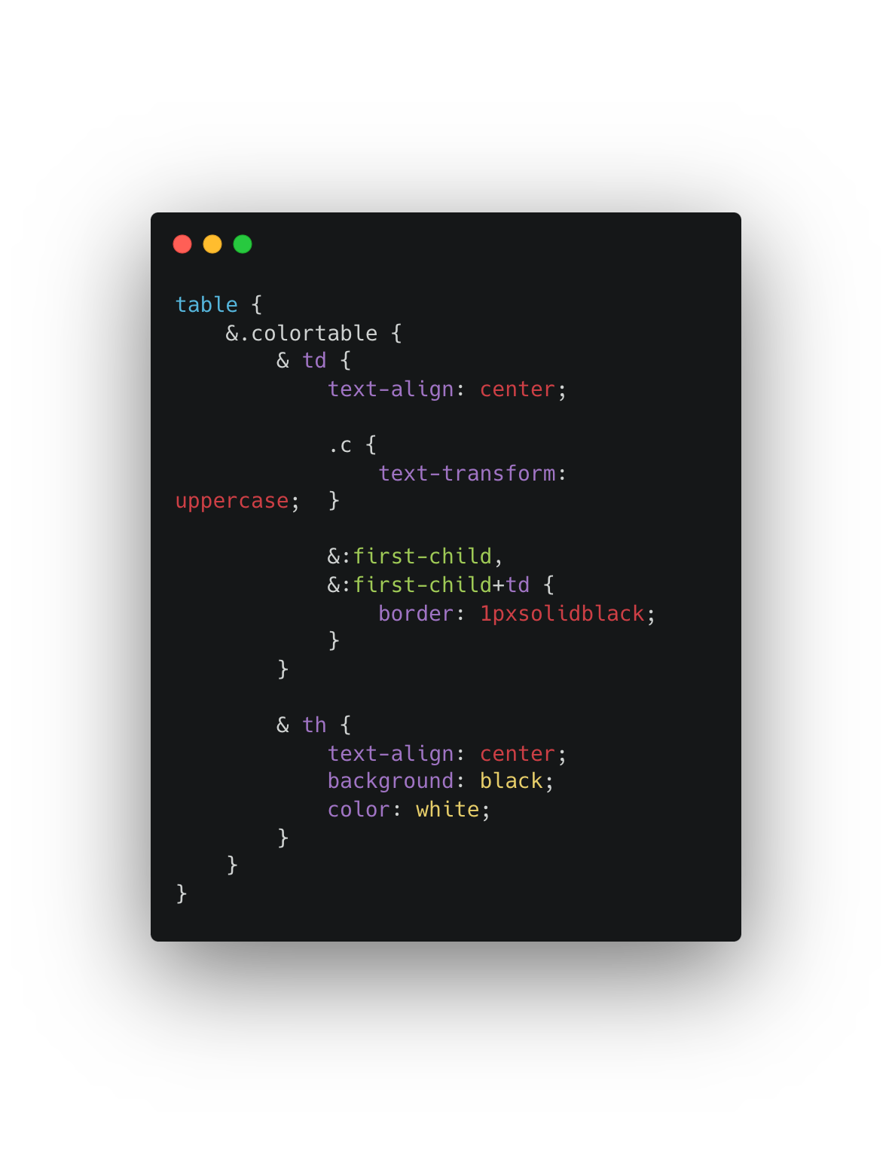


Slide 16
:has()
103
115
115
15.4
https://developer.mozilla.org/en-US/docs/Web/CSS/:has
Notes:
Demo

Slide 17
Space-separated color notation
52
65
79
12.1

Slide 18
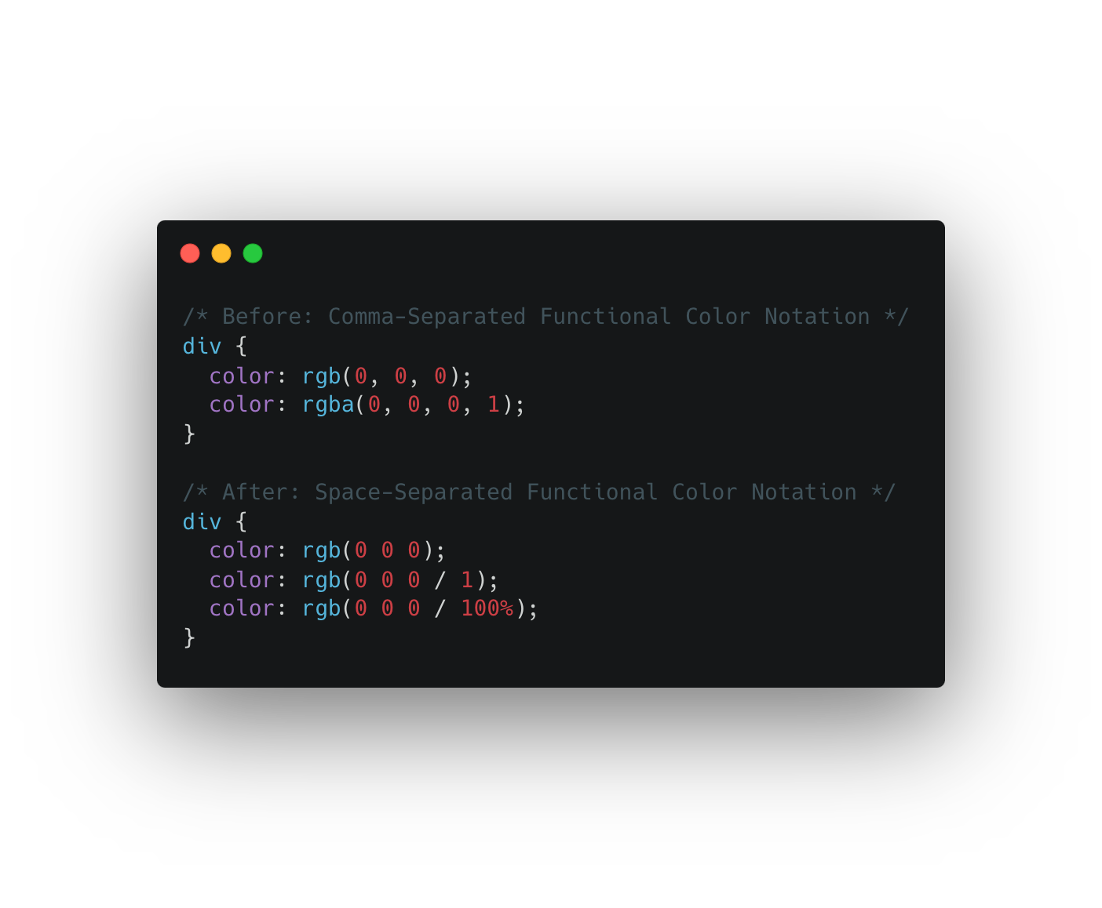

Slide 19
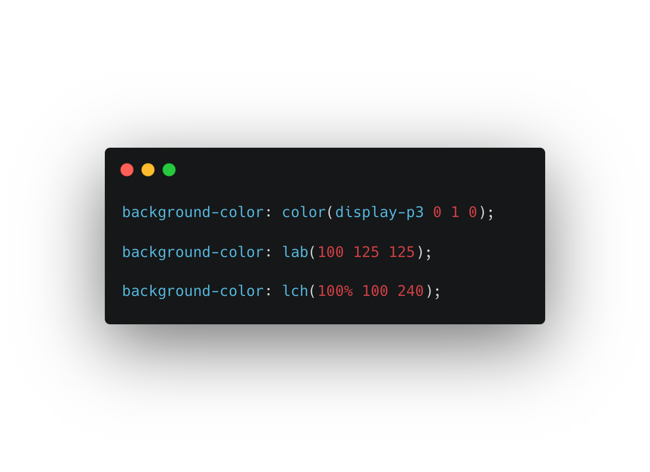

Slide 20
color-mix()
113
111
111
16.2
Notes:
https://stackblitz.com/edit/web-platform-kowtr2?file=styles.scss

Slide 21
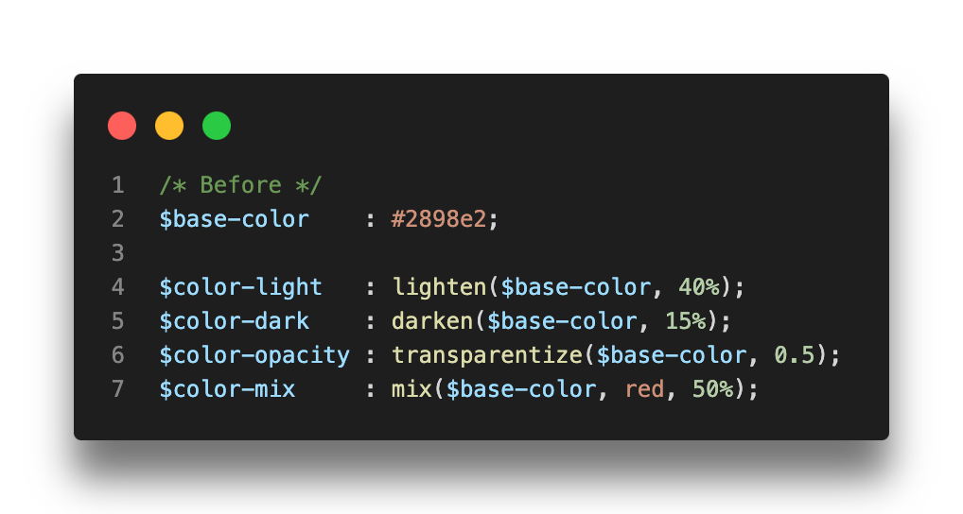
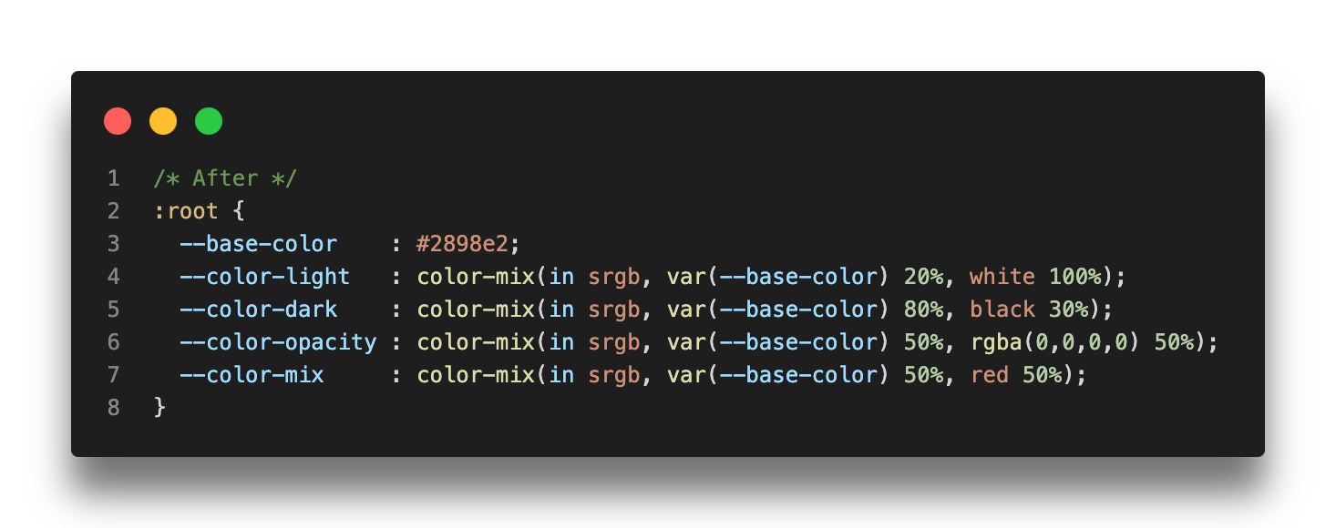
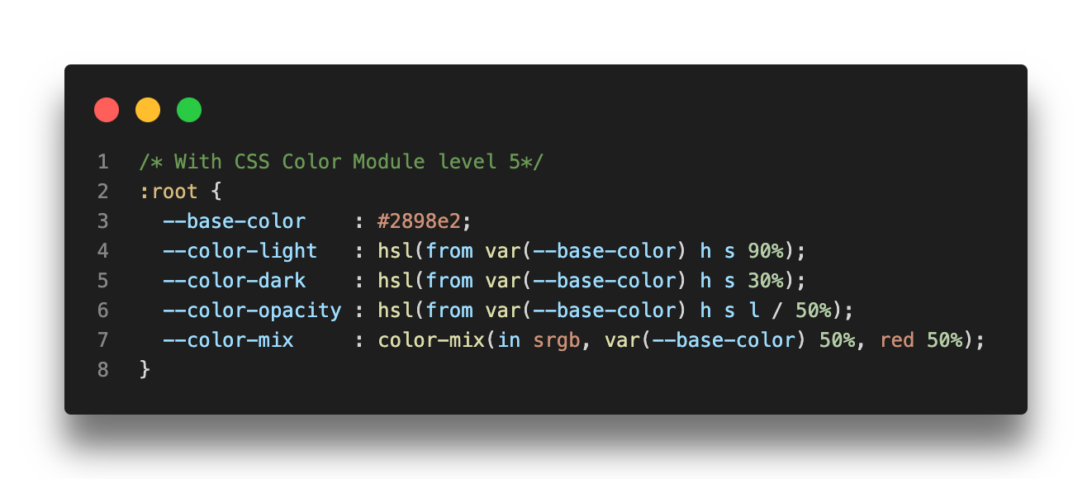

Slide 22
Media query ranges
102
104
104
16.4
https://developer.mozilla.org/docs/Web/CSS/CSS_media_queries/Using_media_queries

Slide 23
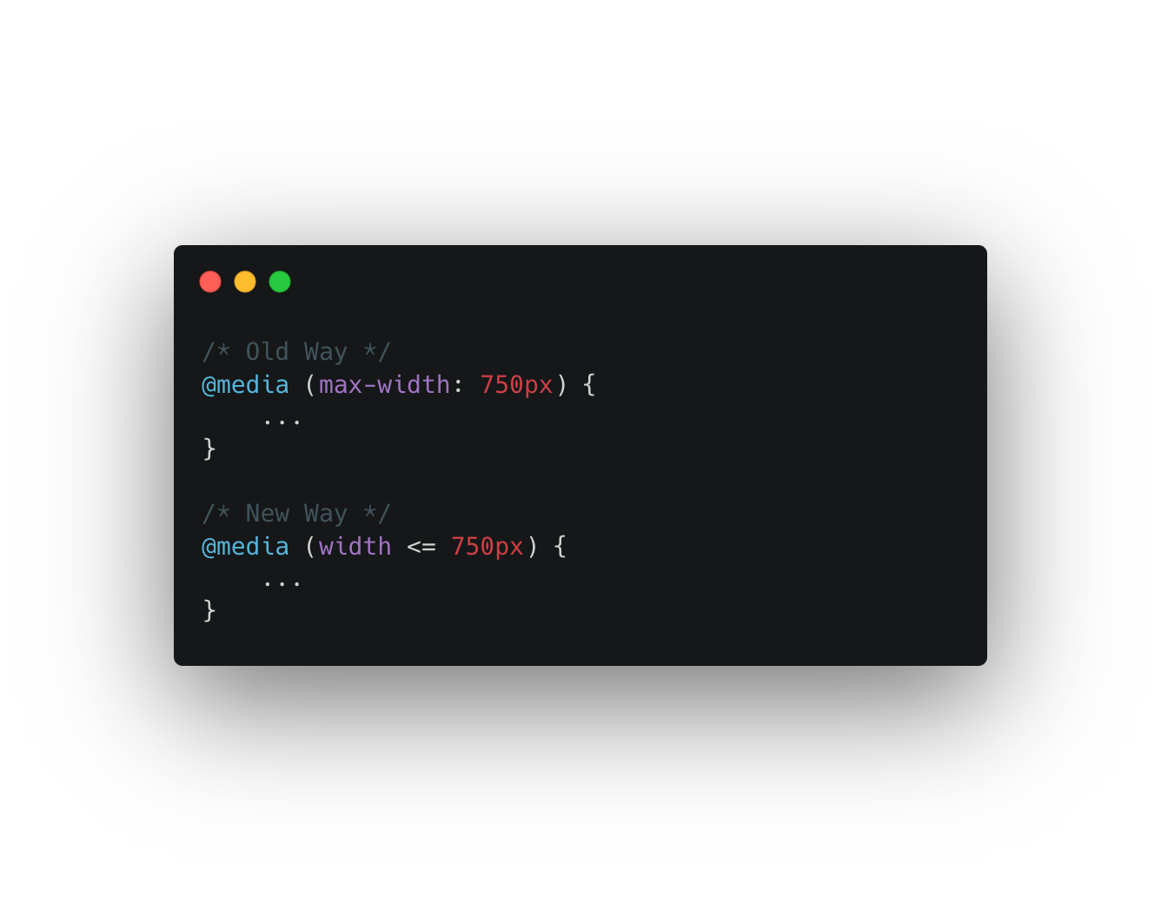
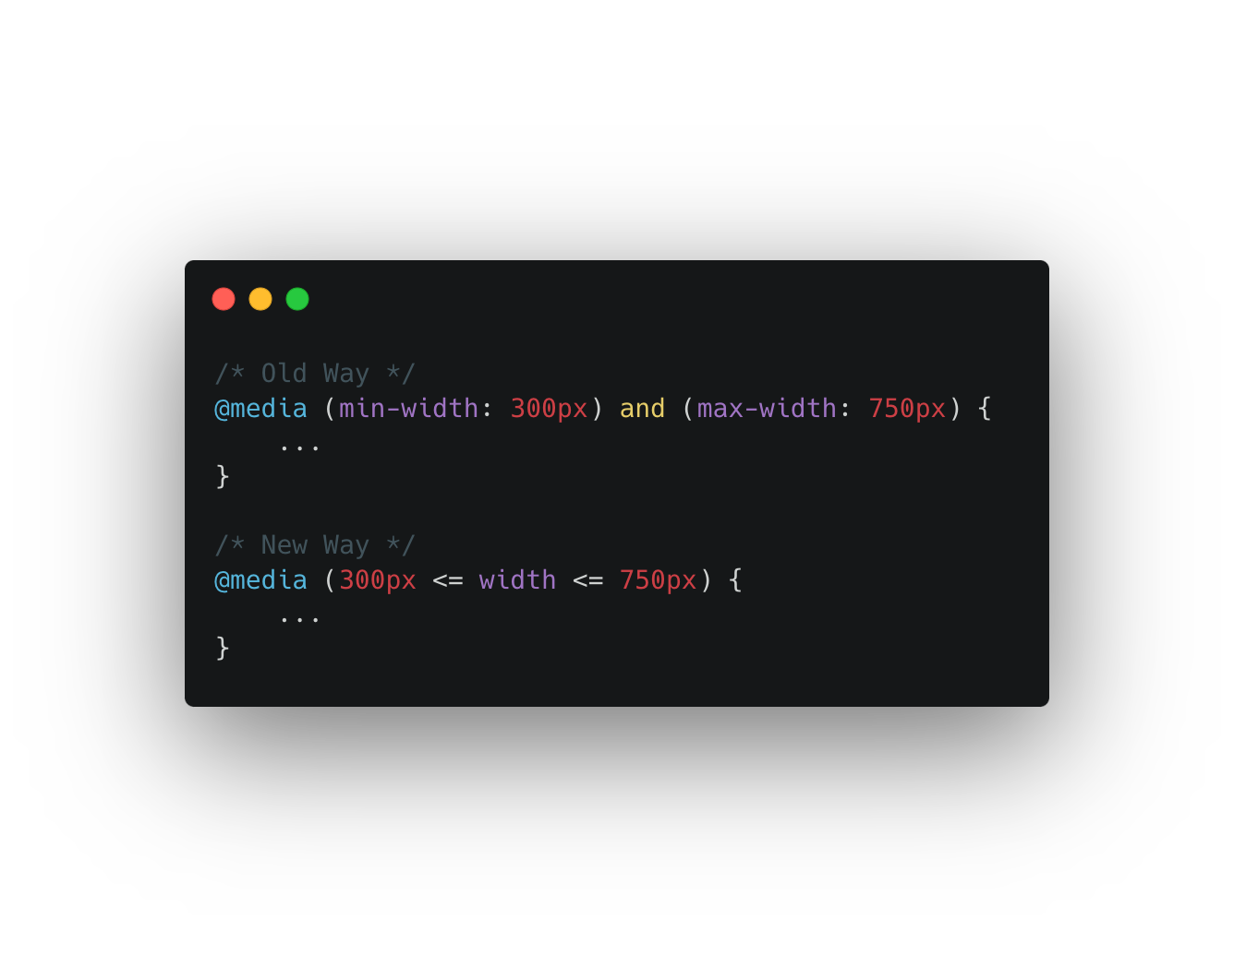

Slide 24
Subgrid
71
X
X
16
https://developer.mozilla.org/docs/Web/CSS/CSS_media_queries/Using_media_queries

Slide 25
Container queries
110
105
105
16
Notes:
https://www.youtube.com/watch?v=3_-Je5XpbqY

Slide 26
Let’s scroll
Notes:
Smooth scrolling
Scroll snapping

Slide 27
Viewport units
101
108
108
15.4

Slide 28
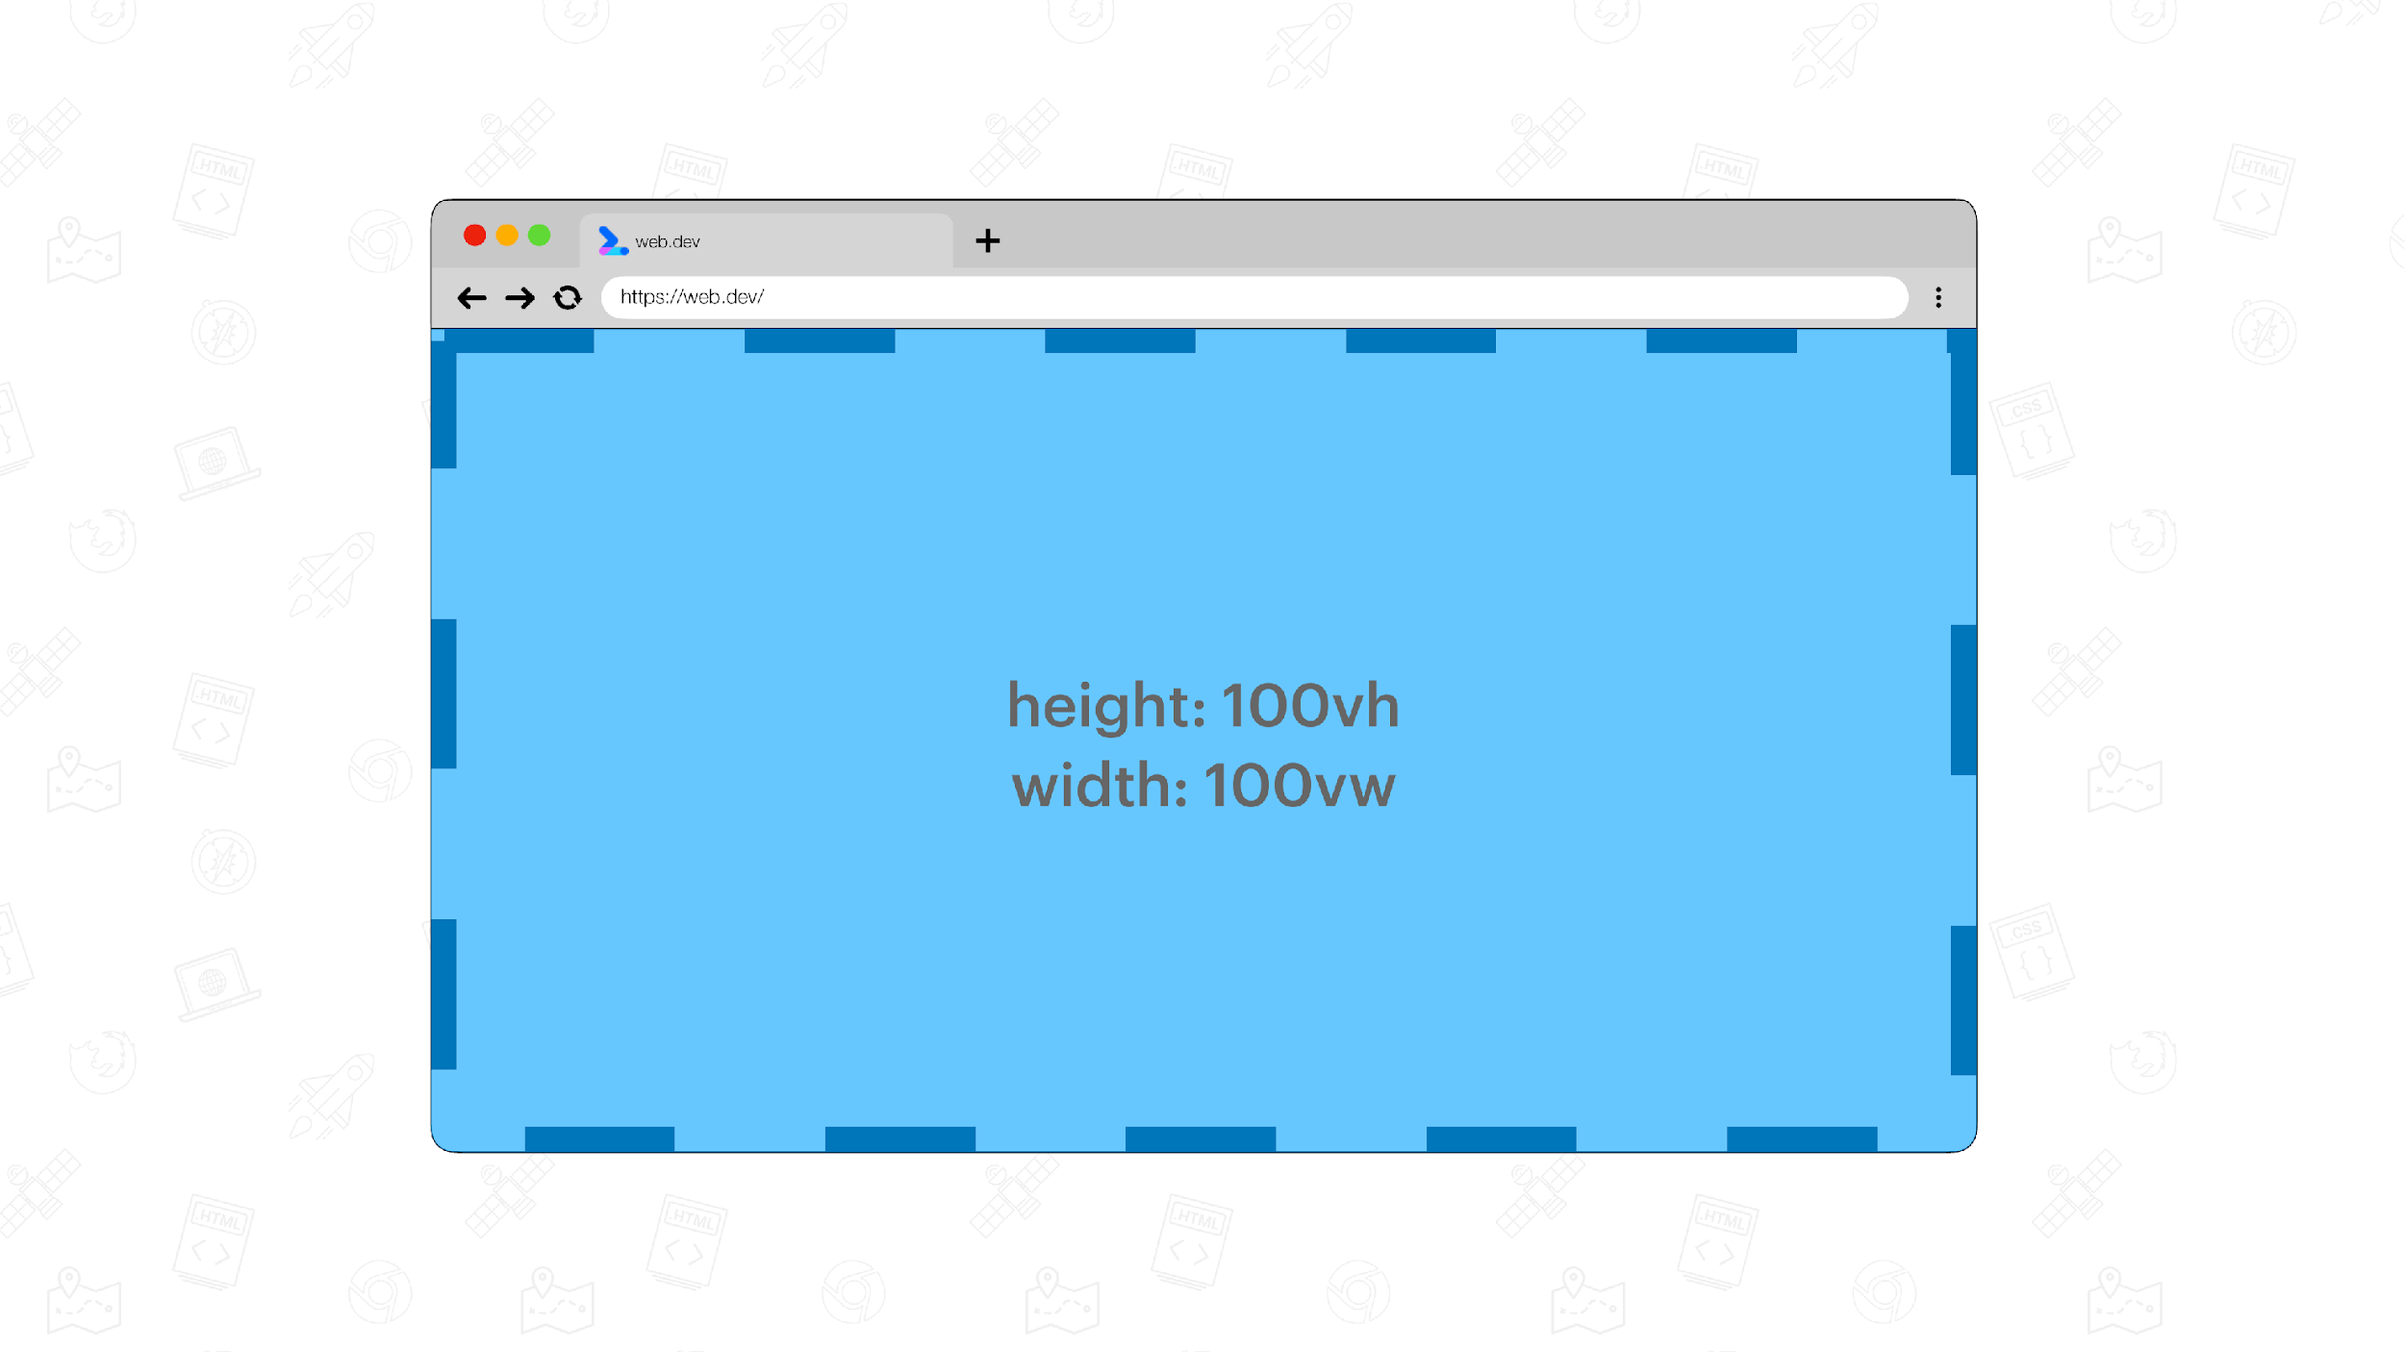
Image source: https://web.dev/viewport-units/

Slide 29
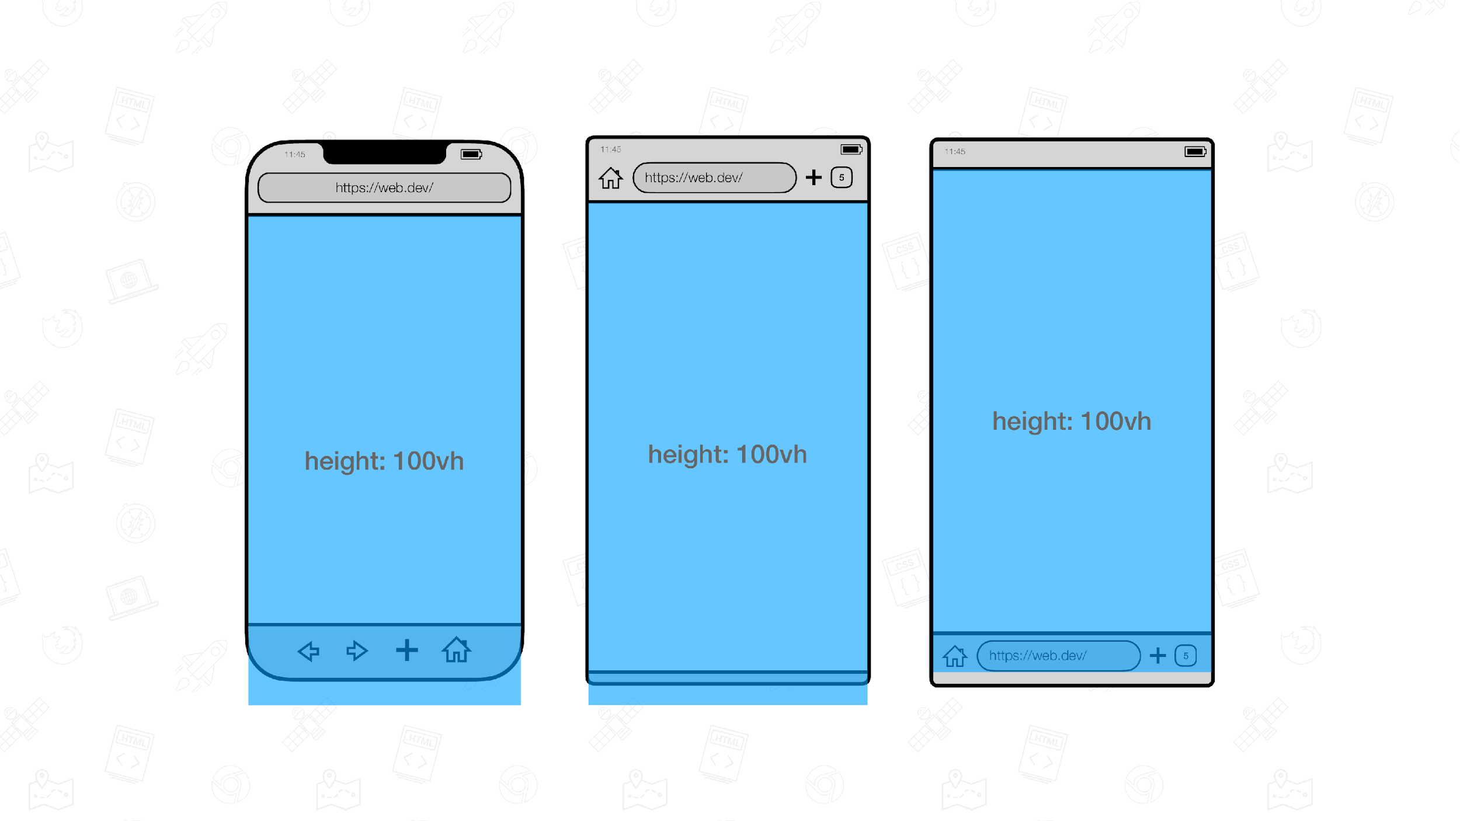
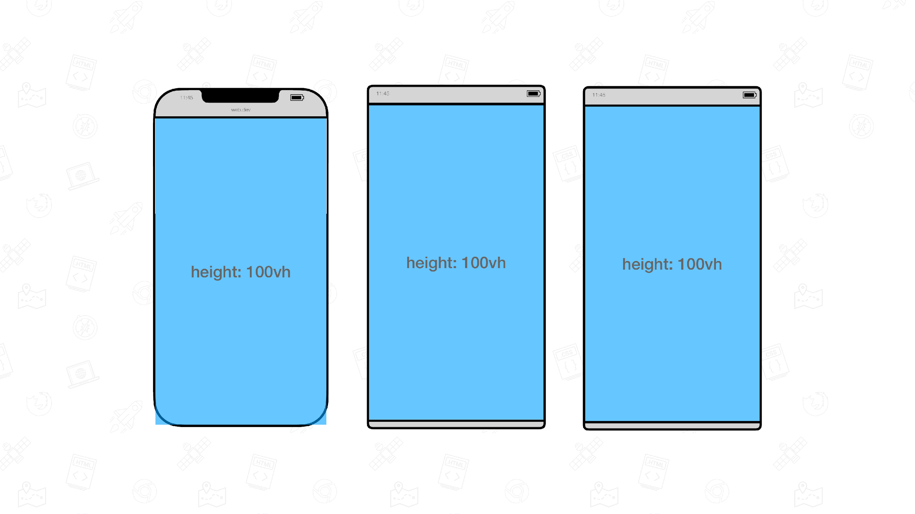
Image source: https://web.dev/viewport-units/

Slide 30
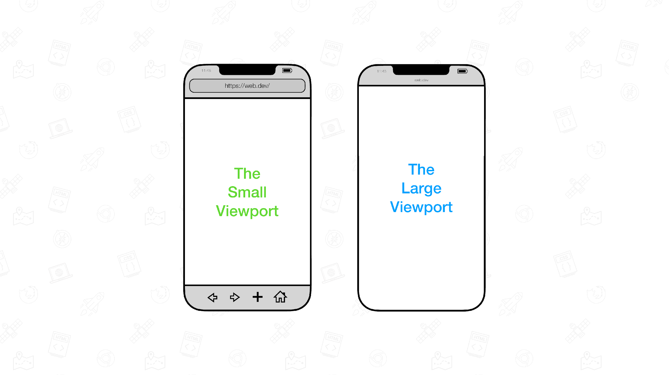
Image source: https://web.dev/viewport-units/

Slide 31
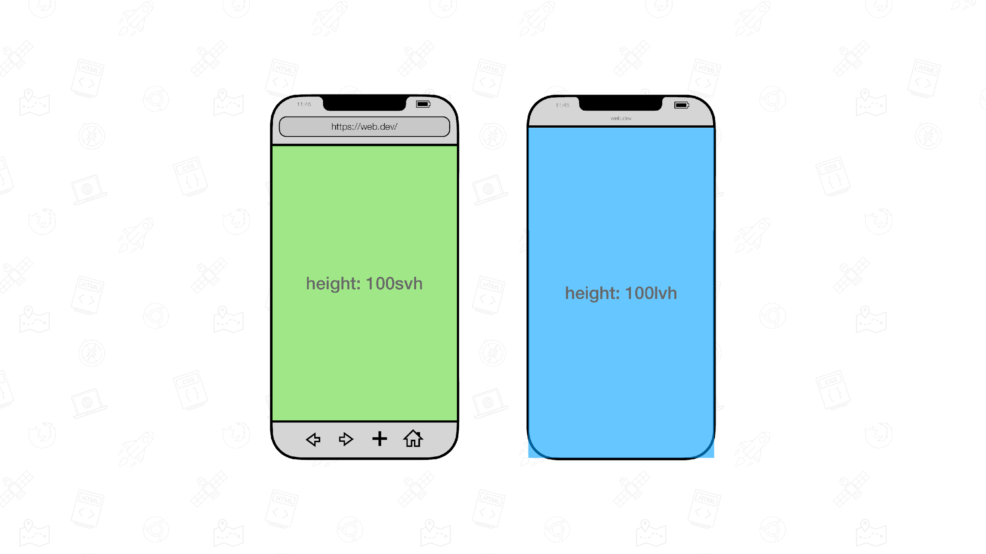
Image source: https://web.dev/viewport-units/

Slide 32
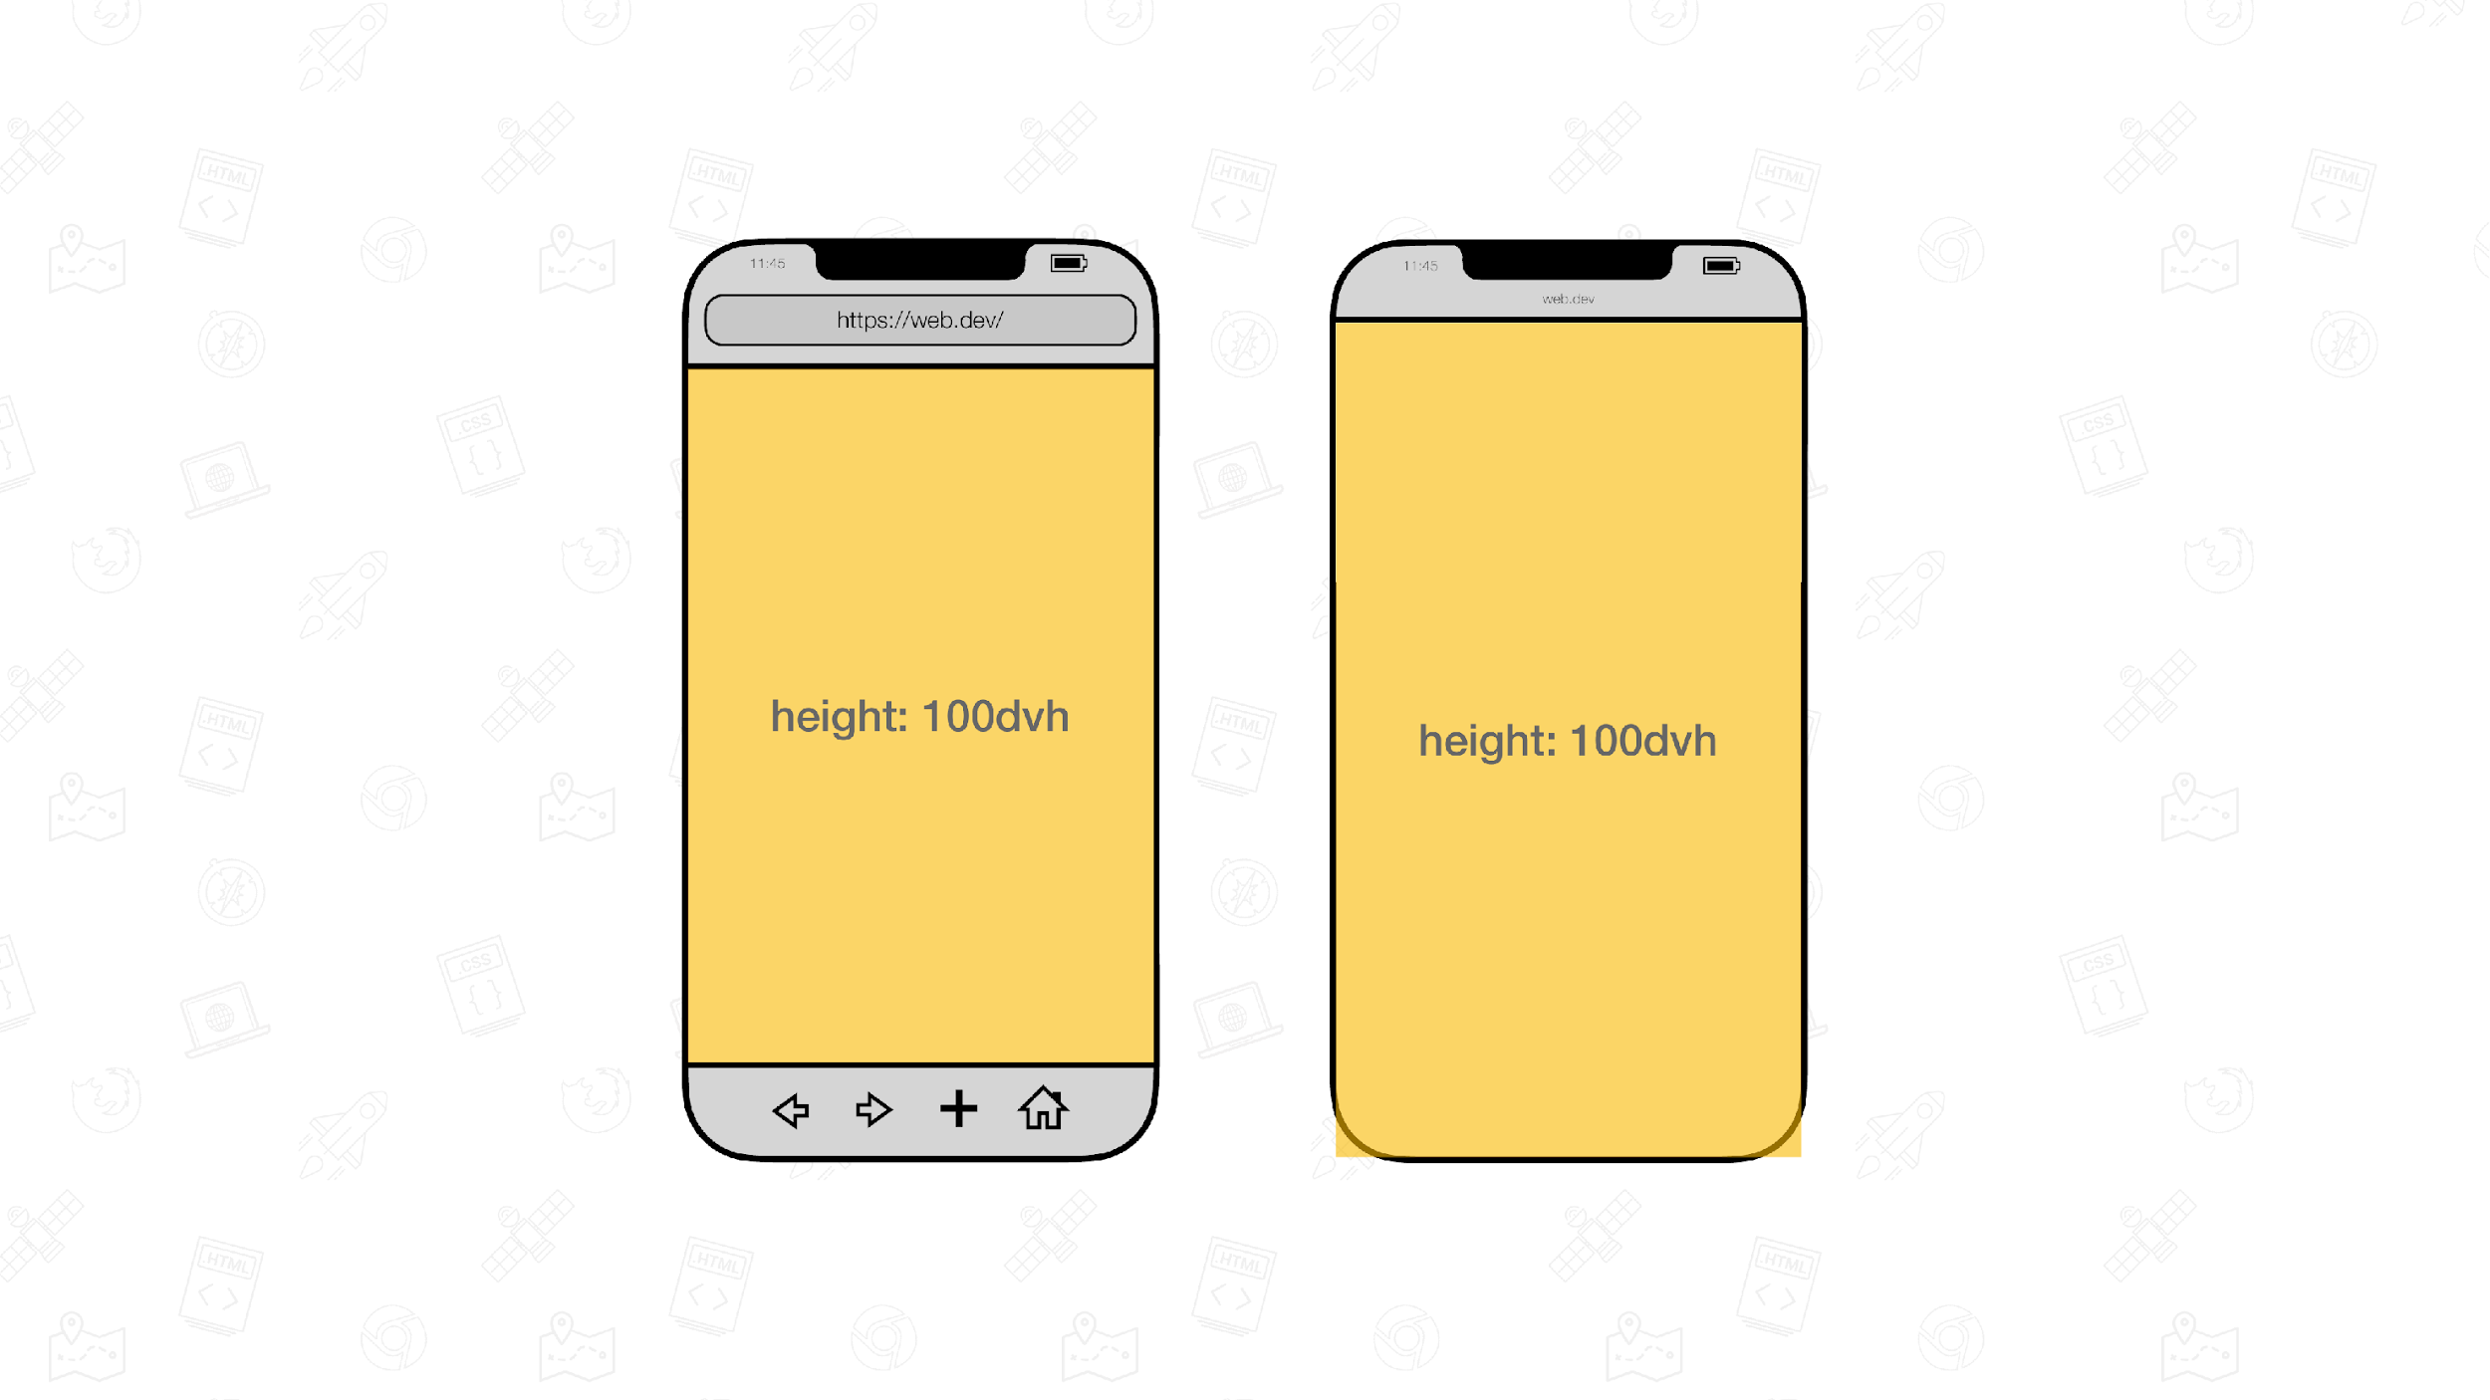
Image source: https://web.dev/viewport-units/

Slide 33
aspect-ratio
89
88
88
15

Slide 34
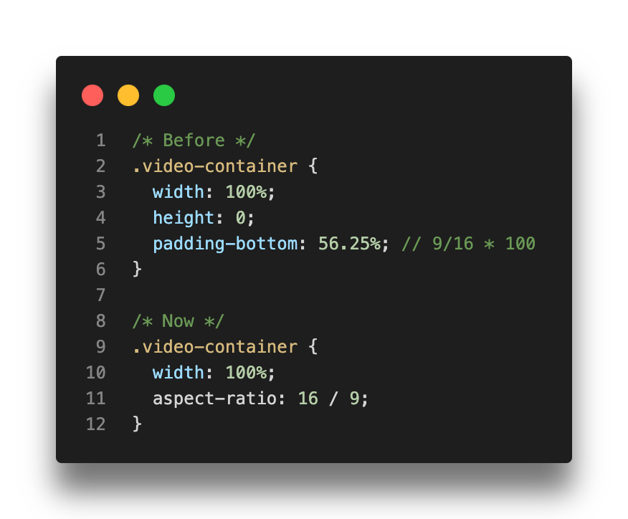
Notes:
+ demo for images when not loaded

Slide 35
:focus-visible
85
86
86
15.4

Slide 36
View transitions
X
111
111
X
https://developer.chrome.com/docs/web-platform/view-transitions/
Notes:
When .startViewTransition() is called, the API captures the current state of the page.
Once that's complete, the callback passed to .startViewTransition() is called. That's where the DOM is changed. Then, the API captures the new state of the page.
https://live-transitions.pages.dev/

Slide 37


color-contrast()
X
X
X
15
Notes:
Open https://webaim.org/resources/contrastchecker/

Slide 38
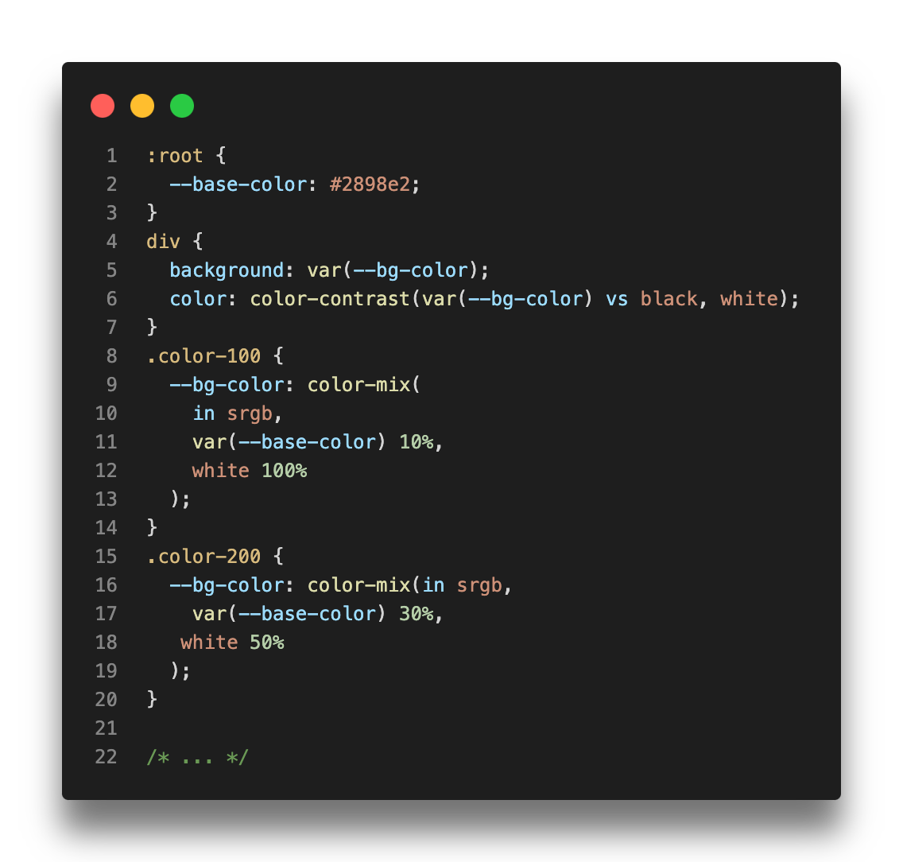
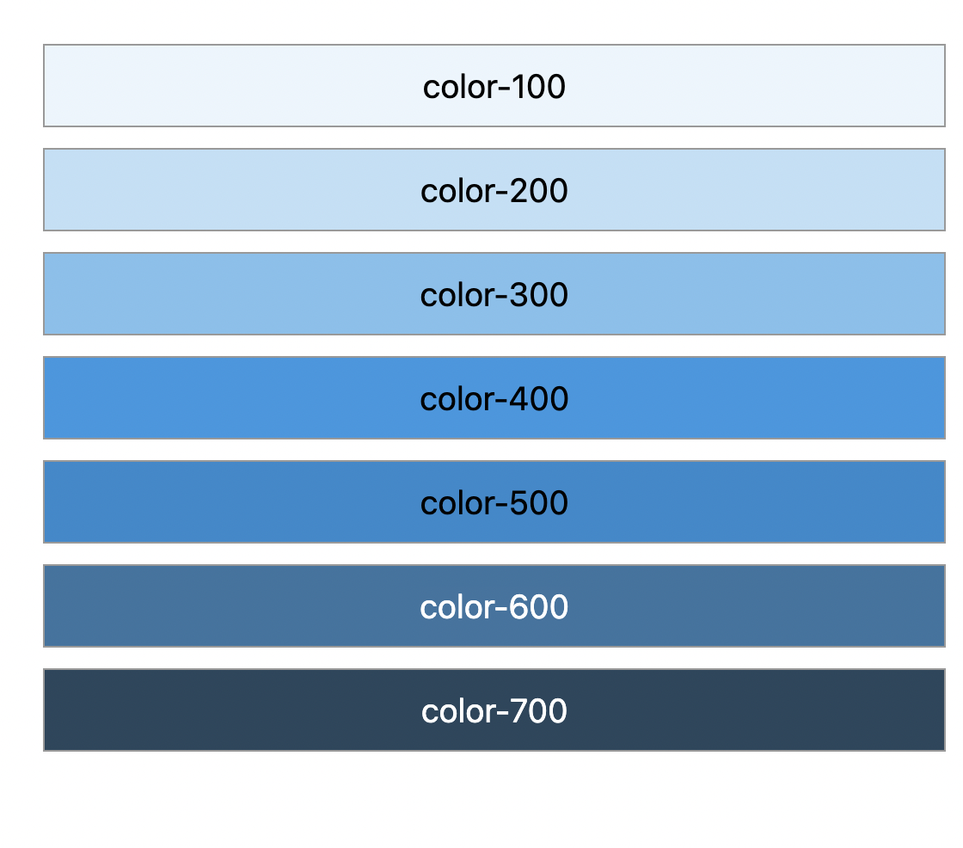
https://webaim.org/resources/contrastchecker/

Slide 39
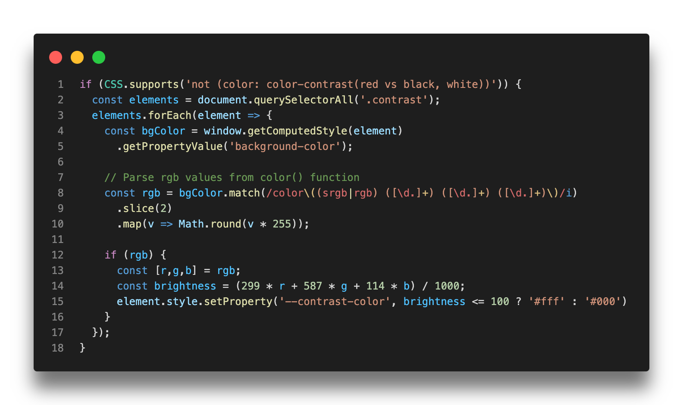

Slide 40
prefers-contrast
101
96
96
14.1

Slide 41
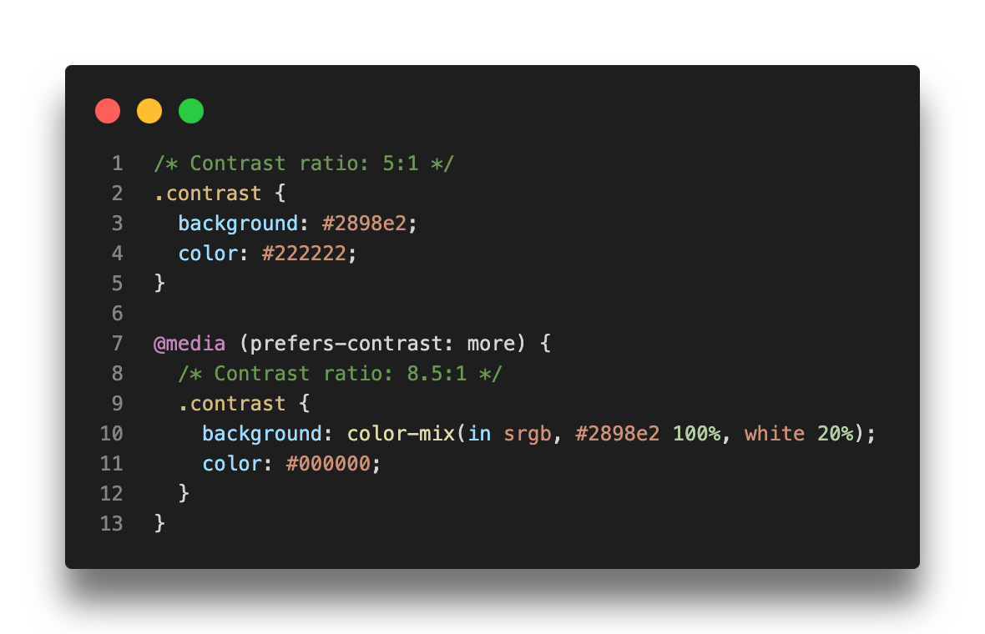

Slide 42
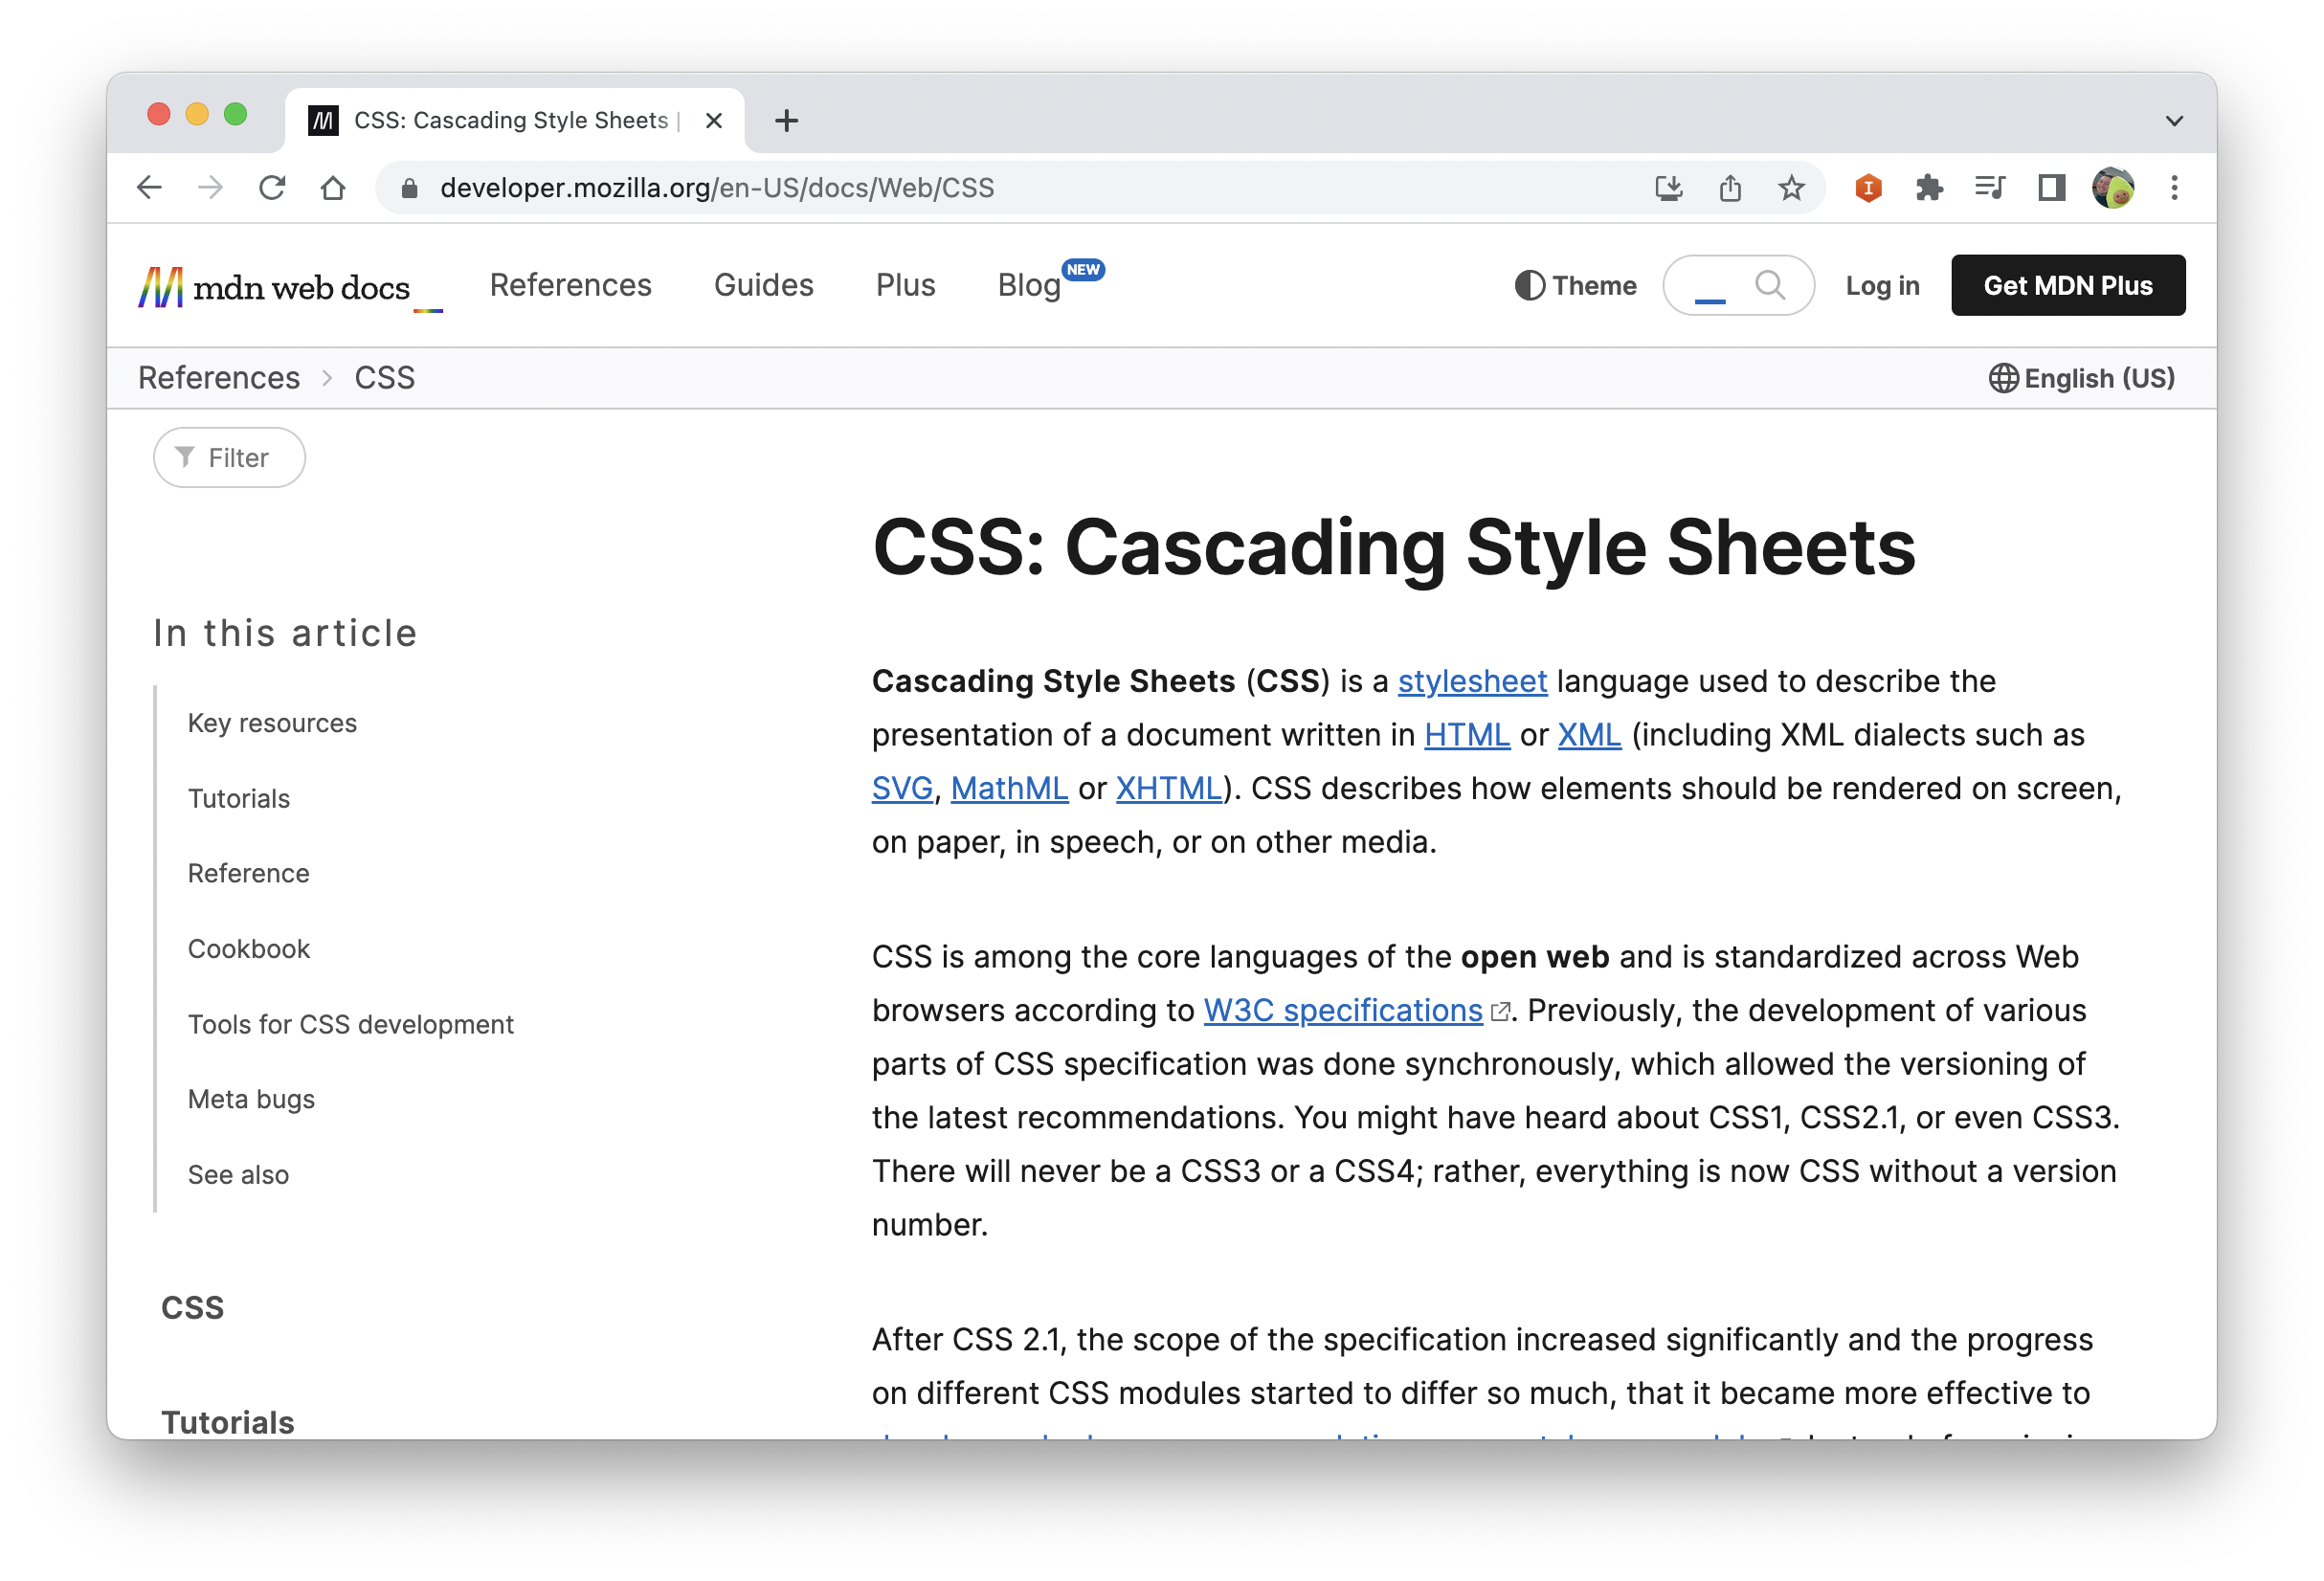
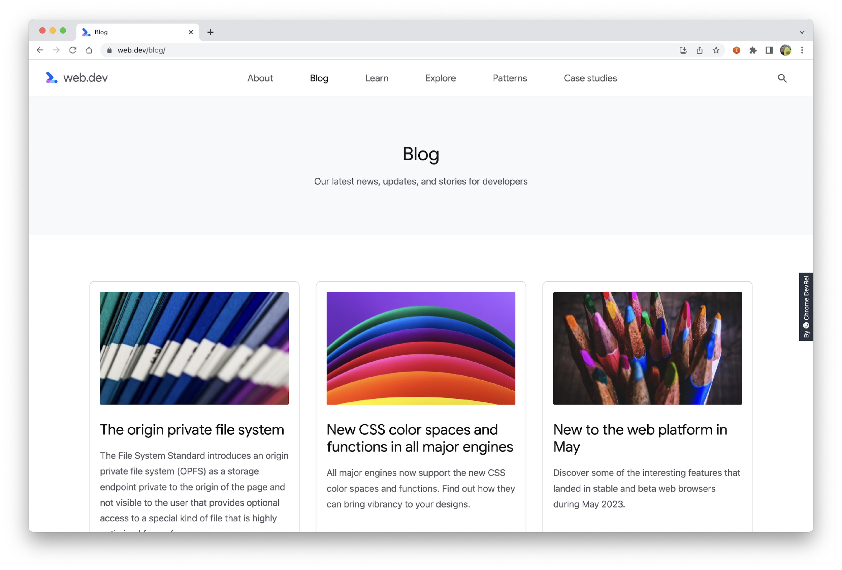
Resources
https://developer.mozilla.org https://web.dev

Slide 43
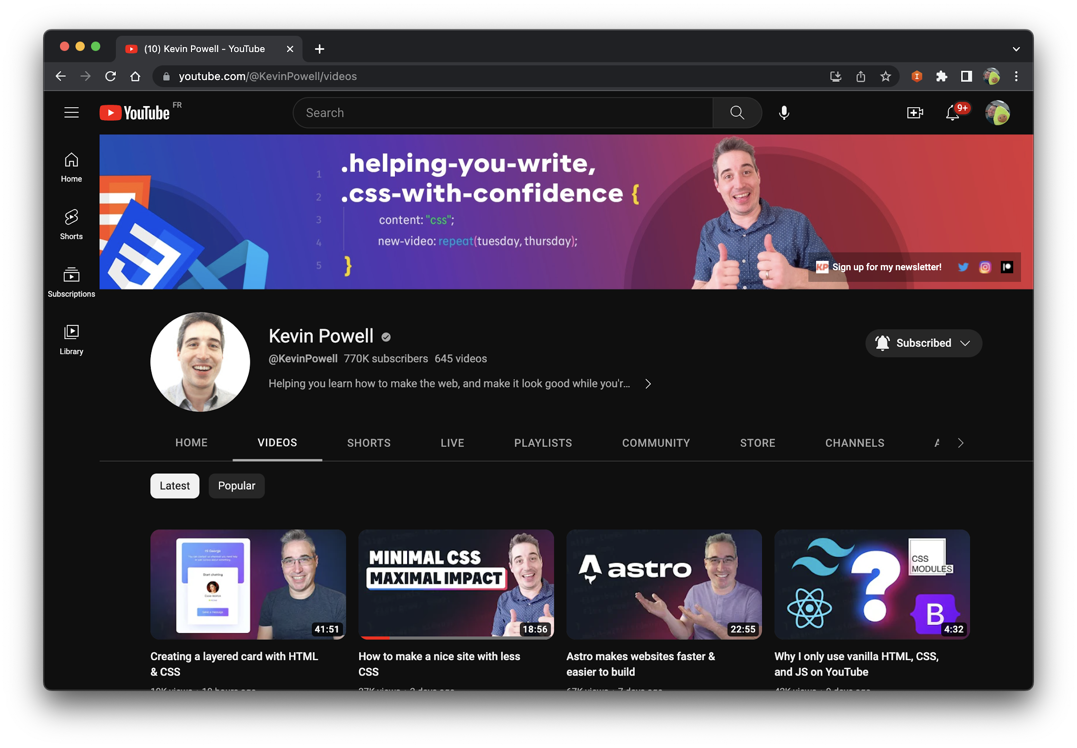

Slide 44

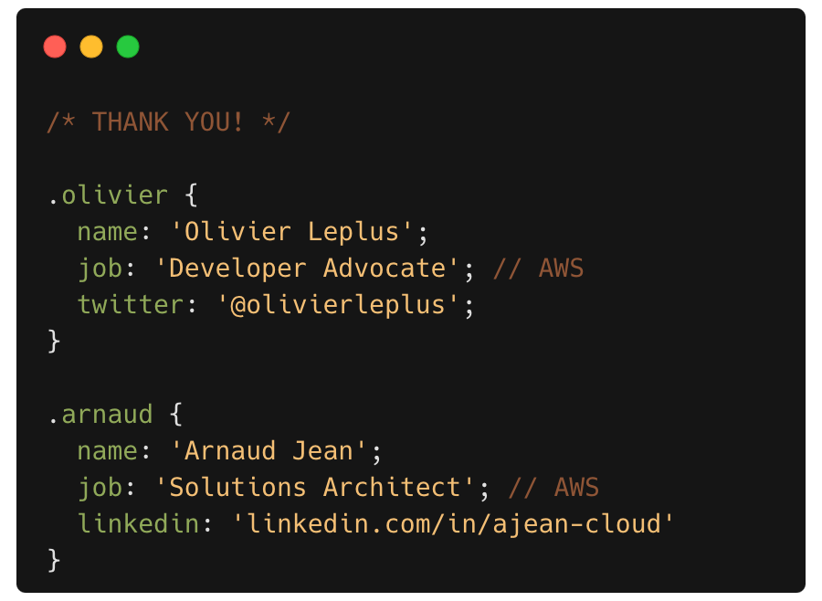

Feedback

Slide 45
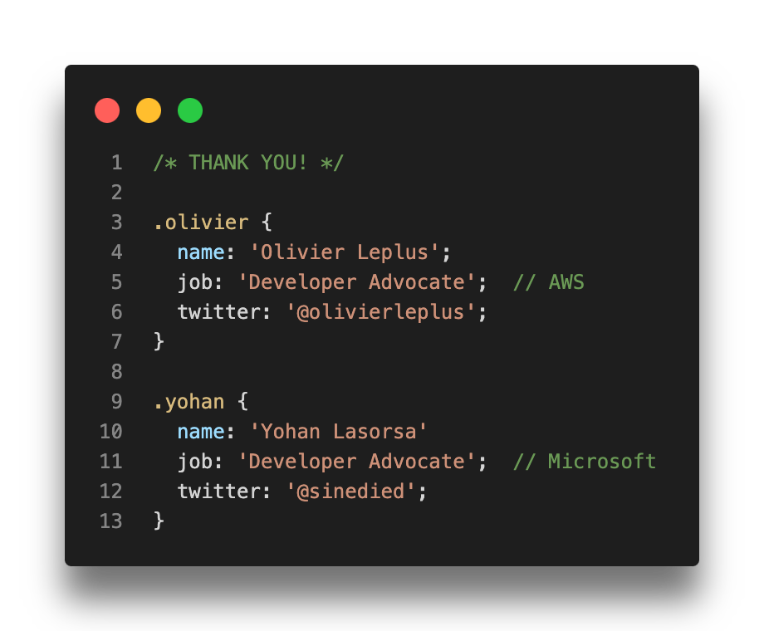

Feedbacks

